Slide 1
ENVIRONMENTAL POLLUTION
The unfavourable changes in physical , chemical and biological characteristics of surroundings that is air, water, soil due to several human activities that causes harmful effect on our life or that of other desirable species and cultural assets.
POLLUTANTS: The materials which cause pollution of the environment.
Examples : Gaseous pollutants, metallic contaminants, pesticides, toxic organic and inorganic compounds,carcinogens,mutagens , teratogens, radioactive substances.

Slide 2
SOURCES AND CAUSES OF ENVIRONMENT
Industrial activity
Dumping solid waste
Vehicles
Rapid urbanisation and industrialization
Population overgrowth
Combustion of fossil fuels
Agricultural waste

Slide 3
TYPES OF POLLUTANT
NATURAL DISPOSAL– 1. Non biodegradable-example DDT( Dichloro diphenyl trichloro ethane)
2. Biodegradable-examples smoke, smog , dust particles, metal like iron, lead, zinc etc.
EXISTENCE –1. Qualitative –Naturally do not occur in nature but passed through human activities. Examples DDT, pesticides .
2. Quantitative—components whose concentration reaches beyond a threshold volume, then they act as pollutants. Examples –concentration of Co2,CO, No2 in the atmosphere released by means of fires from different industries.

Slide 4
PRIMARY POLLUTANT– Substances which persists in form in which they are directly added to the environment from some identifiable sources. Eg. DDT
SECONDARY POLLUTANT– Caused due to interaction among primary pollutants. Examples PAN (Peroxy acetyl nitrate), ozone, sulpherdi oxide etc.
INDOOR POLLUTANT: Mosquito repellants, pesticides, paints, varnishes,cigaratte, smoke etc.
OUTDOOR POLLUTANT: Automobile, mining, and industrial pollutants

Slide 5
AIR POLLUTION
The process by which some natural phenomenon or human activities increase the amount of solid waste or concentration of gases other than oxygen in the air which are harmful to man and his environment.
TYPES OF AIR POLLUTANT: 1. Gaseous pollutants- Important gaseous pollutants are carbon di oxide, carbon mono oxide, oxides of nitrogen, sulphur, hydrogen sulphide, hydrocarbons, ozone and other oxidant.
2. Particulate pollutants- Air borne particulate materials consists of both solid and liquid particles. They vary in size, ranging from 0.01micron to 20 micron. Particles with least diameter are present in aerosols.

Slide 6
AIR POLLUTION
SOURCES OF AIR POLLUTION
1.Point sources- These are sources which cause direct release of air pollutants.
Examples: The emission of gases from industry through a chimney.
2. Non point sources-These are sources which release substances which are capable of undergoing chemical reactions in the atmosphere to generate air pollutants.
3. Man made or anthropogenic sources- These are sources which generate air pollutant by human activities.

Slide 7
AIR POLLUTION
CLASSIFICATION OF AIR POLLUTANT- 1. GASEOUS AIR POLLUTANT– Sulphur di oxide, nitrogen oxides, carbon mono oxides, carbon di oxides.
2. PARTICULATE AIR POLLUTANT- Dust, mist, fumes, smoke, aerosols, fog, fly ash soot, smog etc.
3. PRIMARY AIR POLLUTANT- Directly emitted from the sources like carbon di oxide, sulphur di oxides, smoke etc.
4. SECONDARY AIR POLLUTANT- Formed by chemical reactions among primary pollutants and chemical species present in atmosphere.
5. INDOOR AIR POLLUTANT- Mosquito repellant,pesticides,paints,glues,varnishes,cigaratte,smoke etc.

Slide 8
DIFFERENT TYPES OF AIR POLLUTANTS AND THEIR CONSEQUENCES
Carbon monoxides– Sources: 1. Forest Fire
2. Agricultural burning
3. Incomplete combustion of fossil fuels
4. Tobacco smoking
5. Automobile exhausts.
Effects: 1. Reduce oxygen carrying capacity by forming car boxy haemoglobin compounds.
2. Decrease in vision and causes cardio vascular disorder

Slide 9
Carbon dioxides: Sources- 1. Fossil fuel combustion
2. Jet plane use oxygen and release carbon dioxide.
3. Burning
Effects- 1. causes headache and nausea.
2.Effects on climate, increase global temperature.
Sulphur dioxide- Sources- 1. Combustion of coal and petroleum products
2. sulphuric acid plants
3.metallurgical operations

Slide 10
Effects of sulphur dioxides- 1.Irritation of throat and eyes
2. Suffocation
3. Asthma
4. Chronic bronchitis
Oxides of nitrogen: Sources- 1.Nitric acid plants
2. Automobile exhausts
3. Explosives
4.Fertilizer industries

Slide 11
Effects- 1. Headache
2. Respiratory irritation
3. impairment of lung defences
4. corrosion of teeth
5. loss of appetite
Mercury
Sources- 1.Mining and refining of mercury
2. industries linked with manufacture of medical products
Effect- 1.Inhalation of mercury vapours cause toxic effects
2. Highly toxic organo mercurical may cause damage of brain and nervous system.

Slide 12
LEAD
Sources- 1. Automobile emission, electroplating waste, plumbing, lead paint industry, printing etc.
Effects- Liver and kidney damages, mental retardation in children, abnormalities in fertility and pregnancy, gastrointestinal damage.
Particulates matter OR Suspended Particulates matter - Mixture of solid particles and liquid droplets suspended in the air having the diameter size of 0.0002micrometers to 500 micrometers.
TYPES-A. Coarse particles- Diameter size greater than 2.5 micrometers and less than 10 micrometers
B. Fine particles- less than 2.5micrometer.

Slide 13
Sources of particulate matter- 1. volcanoes, 2. Blowing of dust and soil by wind, 3.Forest and grassland fire, 3.fly ash from smelters and mining operations, 4. Smoke from incomplete combustion.
Effects- 1.Chronic respiratory disease 2. Bronchitis, 3. Asthma increase, 4. Birth defects, 5. Lung cancer, 6. Asbestosis
Fly Ash- When coal burns it gives rise to a wide range of particulate matter mainly the metal oxides.

Slide 14
Smog- Smog is the combination of various gases with water vapour and fine particles. Smoke particles get trapped in the fog giving it a yellow or black colour. It is dangerous for plants, animals, human beings and materials.
There are two different types of smog-
Photochemical Smog- This smog is produced when sunlight acts upon motor vehicle exhaust gases such as nitrogen oxides and volatile organic compounds. Ozone, aldehydes, peroxyacetyl nitrates and volatile organic compounds are the main components of photochemicalsmog.

Slide 15
Effects of photochemical smog- Ozone which is the main components of photochemical smog causes sore throats, inflammation, discharges in nasal passage.
In plants ozone attacks plants mainly citrus fruits, potatoes, legumes, soybeans etc.
2. London smog- When sulphur is emitted in large amount and air contains high liquid water contents, then London smog is formed. In 1952, 4000 deaths cause in London due to yellow fog.

Slide 16
CONTROL OF AIR POLLUTION
DEVICE TO CONTROL AIR POLLUTION
CATALYTIC CONVERTER- These are used in almost all of the vehicle to decrease air pollution. These convert pollutants into less harmful product. Carbon monoxide, nitrogen oxides, volatile organic compounds are converted to nitrogen, carbon di oxide and water.
2. GRAVITY SETTLING CHAMBER- It is the least efficient one. Gas containing particulate matter enters into the chamber by the inlet. Particulate matter is separated from the gas inside the chamber .But they are not suitable for particles less than 60 microns.

Slide 17
ELECTROSTATIC PRECIPITATOR- It is the most efficient method among all these methods and it can separated very small sized particulates.
CYCLONE SEPARATORS
FABRIC FILTER.
WET SCUBBER etc

Slide 18
WATER POLLUTION
Water pollution is defined as presence of any foreign substance or energy in water in such concentration and for such duration that tends to degrade the quality of water so that humans, animals or any other organism cannot enjoy the beneficial qualities of water but the use constitutes a hazards.
SOURCES OF WATER POLLUTION-
1. Point sources- Example-Municipal and industrial
2. Non point sources-Mining runoff and acid rain.

Slide 19
ANOTHER SOURCES OF WATER POLLUTION-
1. Municipal pollution- Domestic sewage which includes the discharges from toilets, wash room, kitchens, institutions, commercial and industrial buildings etc.
2. Agricultural pollution- Waste from agricultural practices like plant nutrients, insecticides, pesticides etc are also introduced into water.
3.Mining Pollution- Fines or tailing from ore washing are disposed off in water suspensions, which are ultimately transferred to the natural stream and which,thus,get polluted.
4.Industrial pollution- Most of rivers and fresh water streams are seriously polluted due to industrial effluents. These contain both organic and inorganic hazardous materials and non biodegradable one too.

Slide 20
ORIGIN AND EFFECTS OF DIFFERENT WATER POLLUTANT
PATHOGEN--- disease causing agent like protozoa, viruses,helminth.
SOURCE
1. Sewage discharge
2. Waste water from industries
3. Meat processing
EFFECTS---
1. Cholera, Typhoid, Dysentery, Polio,Giardiasis,Hepatitis.

Slide 21
NUTRIENT---Chemical elements and compounds which are needed for growth of living things. Nitrogen,phosphorus,carbon, sulphur ,calcium, potassium etc are examples of nutrient.
SOURCES– 1.agricultural runoff
2.Waste water from fertilizer industries.
3. Sewage disposal
EFFECTS– Eutrophication-Nutrients can increase the growth of algae and other organic matter. Leads to algal bloom. The dissolved oxygen of water is used up by them. Many fish and other animals are killed due to lack of dissolved oxygen. This disturb the nitrogen and phosphorus cycle.

Slide 22
HEAVY METALS– SOURCES
1. Mining and processing of ores.
2. Mine drainage and leaching of mining wastes.
3. power plants
4. weapons production industries.
Effects-
Mercury Nitrates– Causes minamata disease ( Japan 1952), Blue baby syndrome in infants. Chromosomal damage.
Lead- Dyslexia disease Nausea, vomoting,loss of appetite anaemia, damage to liver, kidney, brain cells, mental retardation, increase blood pressure, loss of muscle elastricity.

Slide 23
Arsenic-Black foot disease causes diarrhoea.
Cadmium-Itai-Itai disease. Deformities in skeletal system, heart diseases, high blood pressure, Anaemia, brittle bone, severe pain in bones and joints.
Fluoride—Knock knee disease. A condition of having the knees turned inward.
Zinc– Cramps, renal damage.
Copper –Uraemia
Chromium– Gastrointestinal ulcers, disorders developed in the nervous system.

Slide 24
CONTROL OF WATER POLLUTION
Waste water Treatment process- Waste water treatment operates in following four sequences..
1.Pre treatment—Large solid like plastics, sticks, rags can be easily removed during this treatment.
2. Primary treatment—In this steps grinder, separators can be used. It uses screening process, communitor, grit chambers etc. Metals ,rocks are caught in this process.
3 Secondary treatment- Secondary treatment process mainly involves the biological treatment process. Micro organisms degrade the biological content of the sewage.
Following are the commonly used methods for secondary treatment processes..
1.Trickling filter.
2. Rotating Biological Contactor
3. Activated sludge
4. Oxidation Pond.

Slide 25
Activated Sludge- This method uses the suspended growth of microorganisms to remove biological oxygen demand and suspended solids in water.
Oxidation pond- they are used to receive waste water that has been already passed through a stabilization pond or primary settling tanks.
Tertiary treatment

Slide 26
NOISE POLLUTION
Vibrations transmitted through an elastic medium like air, water, soil with frequencies in the approximate range of 20 to 20,000 hertz capable of being detected by ears is known as sounds.
The word noise comes from Latin word nausea meaning sea sickness.
Noise pollution is defined as environmental noise or an unwanted sound that is annoying , distracting, physically harmful.
Decibel is used as a measure of sound intensity level.

Slide 27
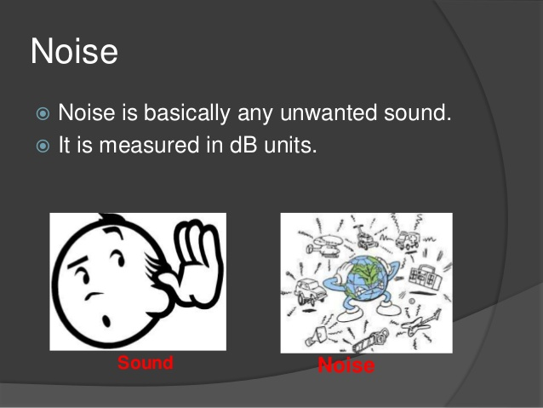

Slide 28
Sound level 80dB—Level of tolerance
90dB– Hearing loss begins if a person is exposed for eight hours a day.
140dB – Painful level of noise
180dB—Very harmful level.
The Noise pollution ( Regulation and Control ) Rules, 2000 of the central govt. –
Area Limits in dB
Day Time Night time
1.Industrial Area 75 70
2.Commercial Area 65 55
3.Residential Area 55 45
4.Slience Zone 50 40

Slide 29
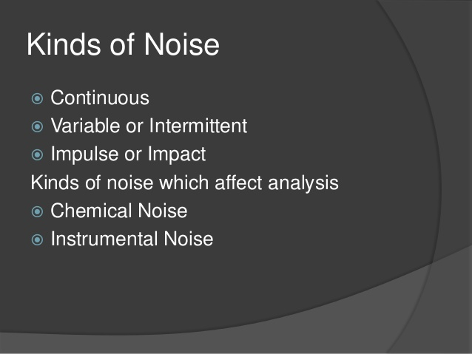

Slide 30
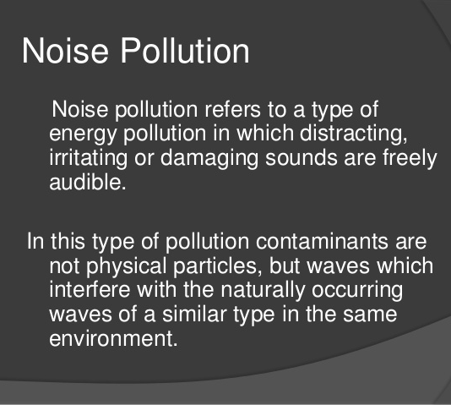

Slide 31
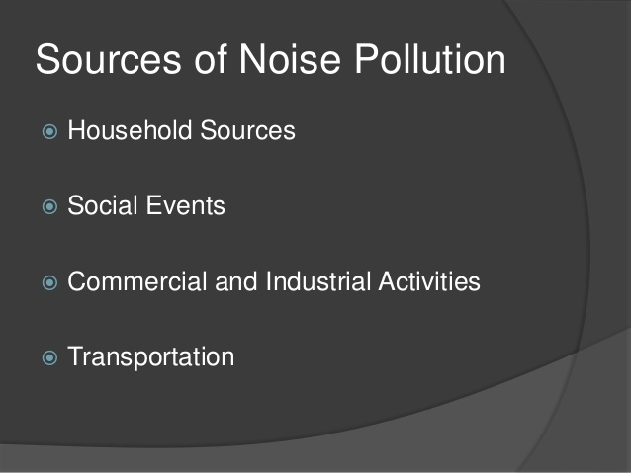

Slide 32
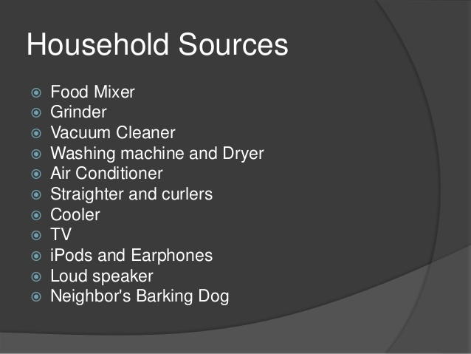

Slide 33
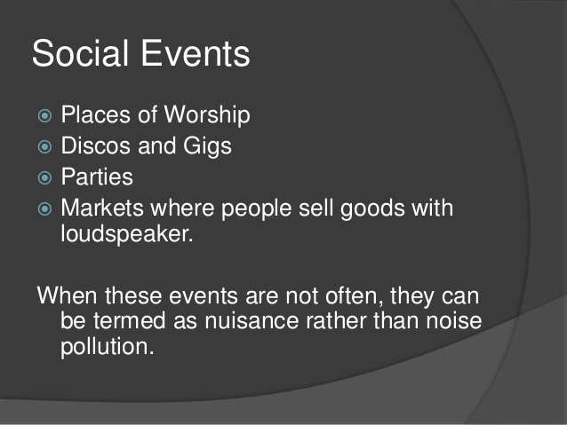

Slide 34
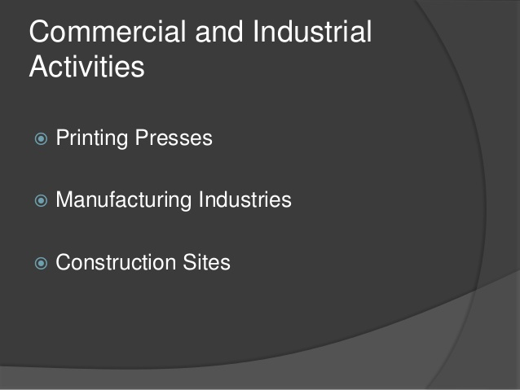

Slide 35
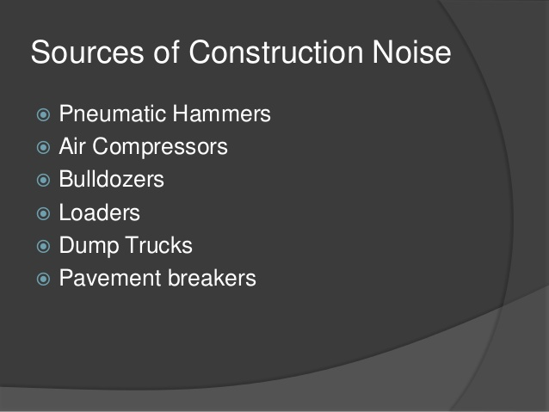

Slide 36
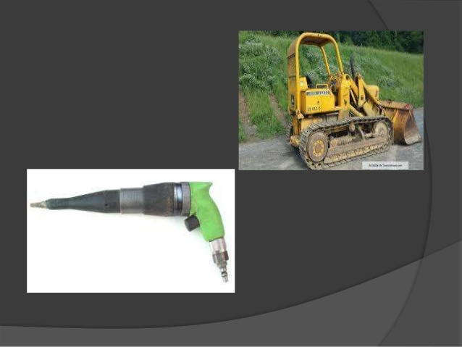

Slide 37
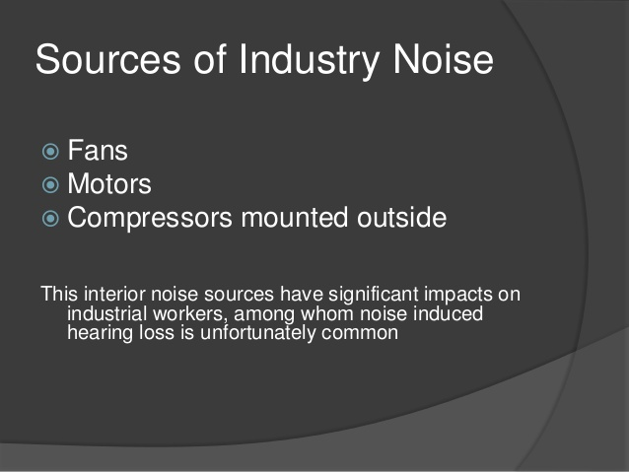

Slide 38
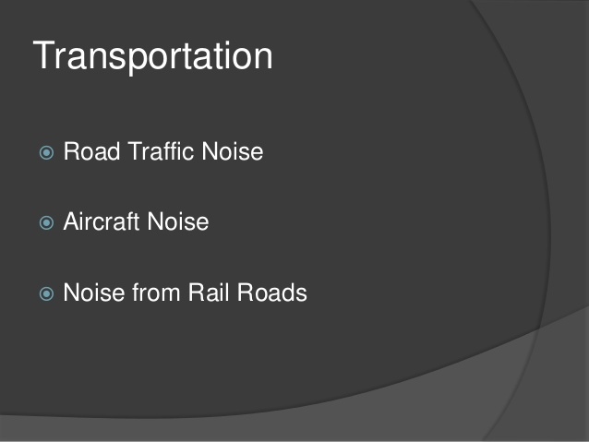

Slide 39
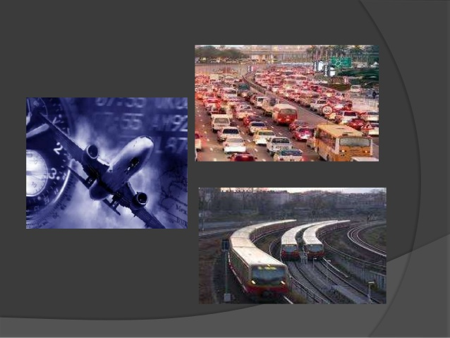

Slide 40
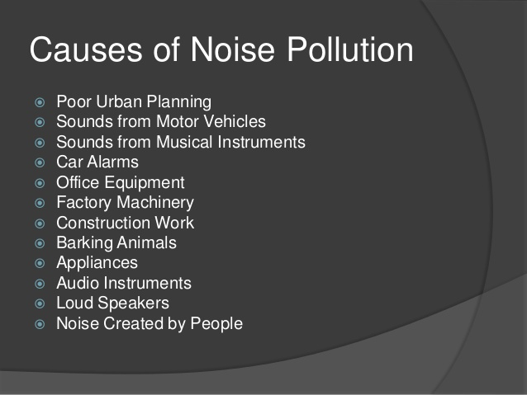

Slide 41
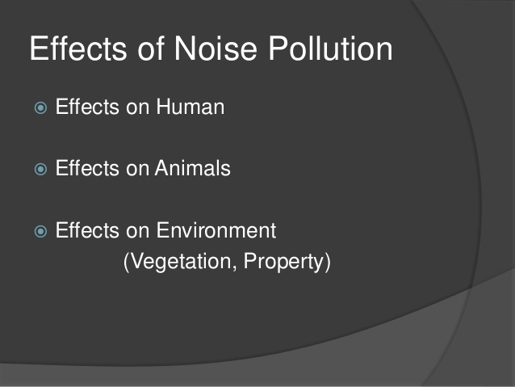

Slide 42
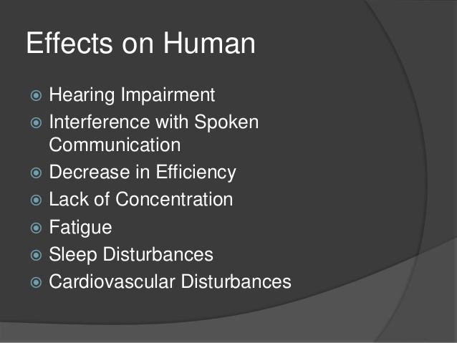

Slide 43
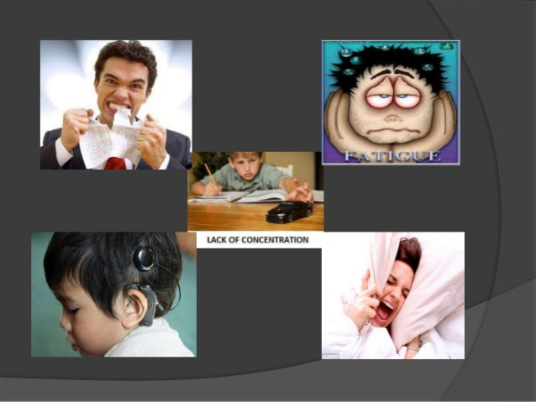

Slide 44
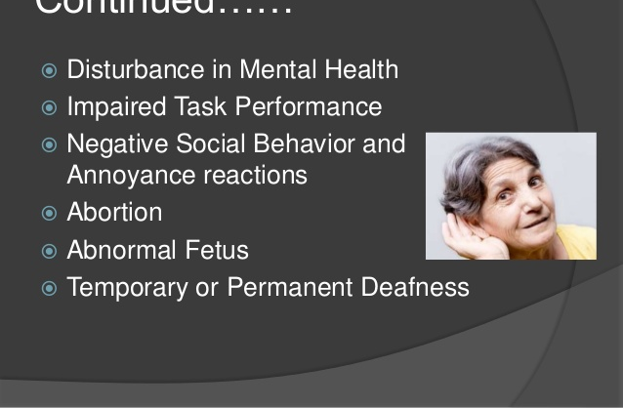

Slide 45
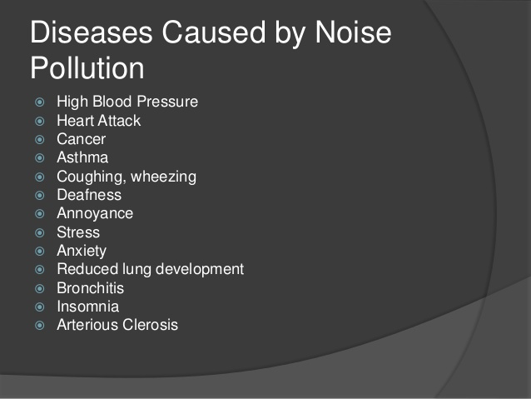

Slide 46
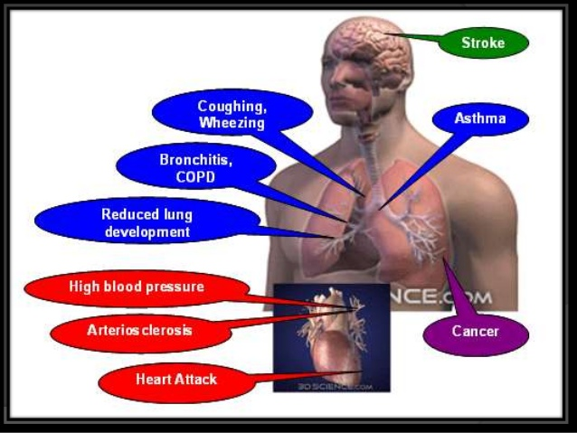

Slide 47
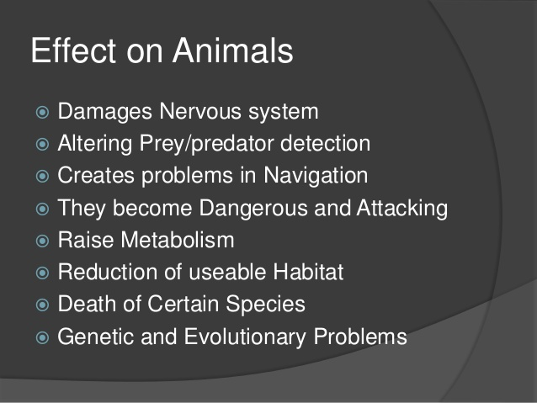

Slide 48
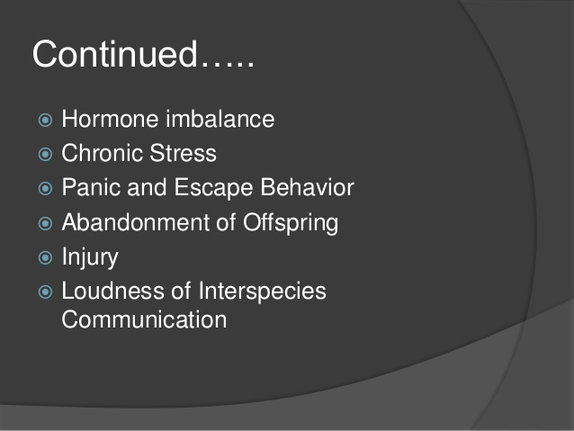

Slide 49
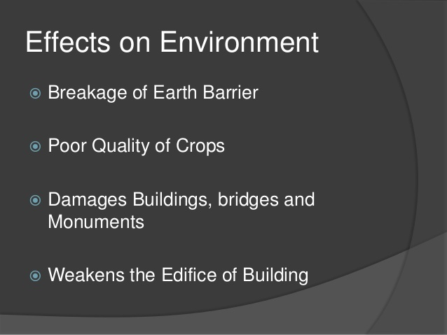

Slide 50
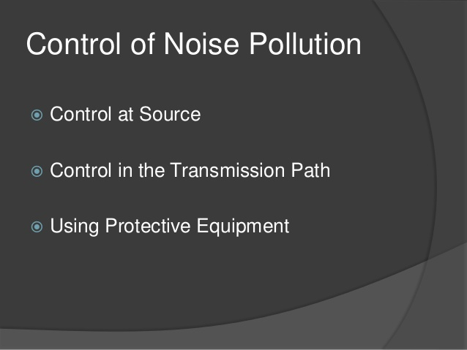

Slide 51
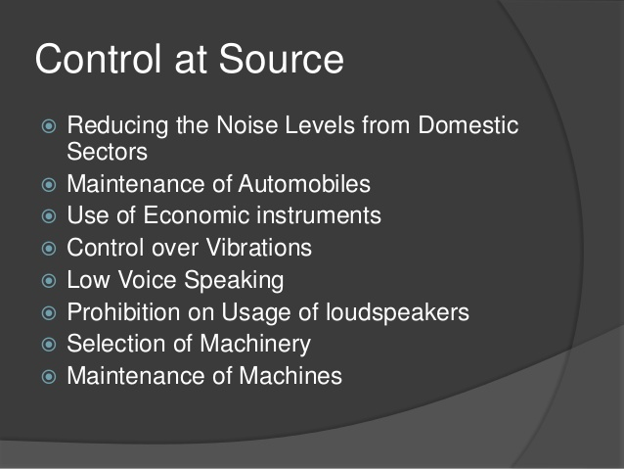

Slide 52


Slide 53
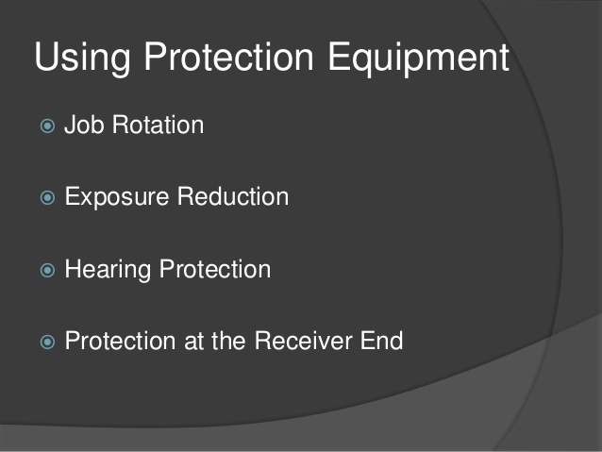

Slide 54
SOIL OR LAND POLLUTION

Slide 55
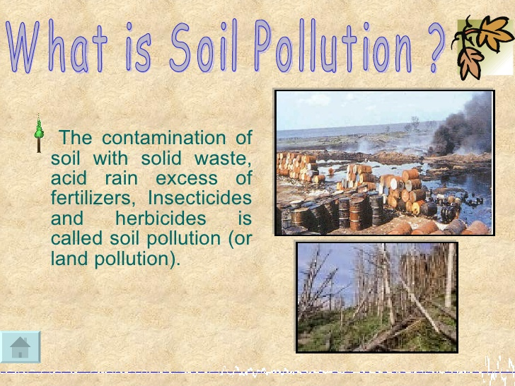

Slide 56
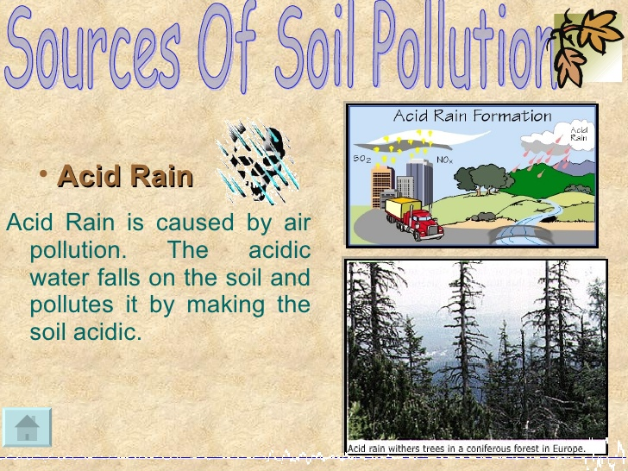

Slide 57
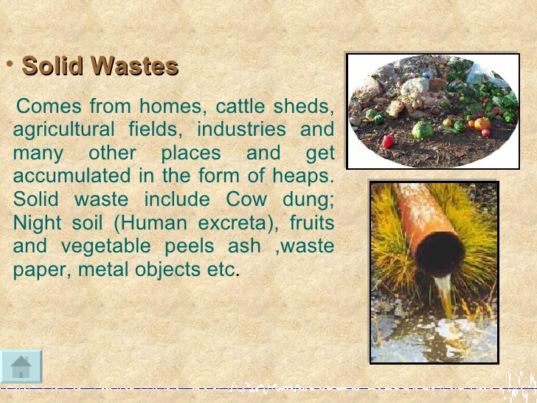

Slide 58
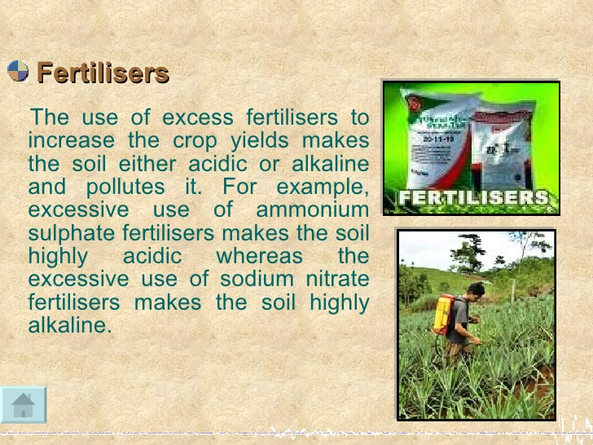

Slide 59
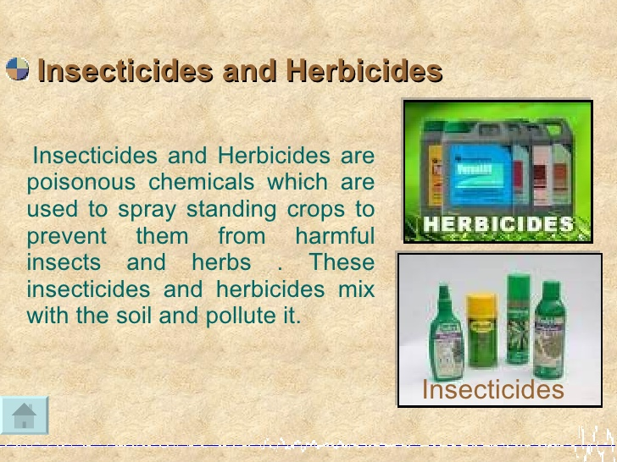

Slide 60
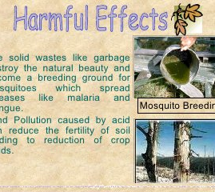

Slide 61
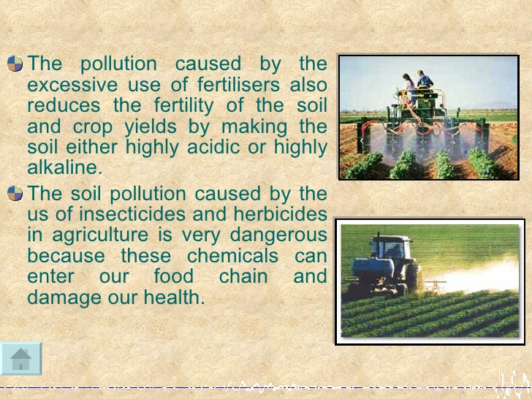

Slide 62
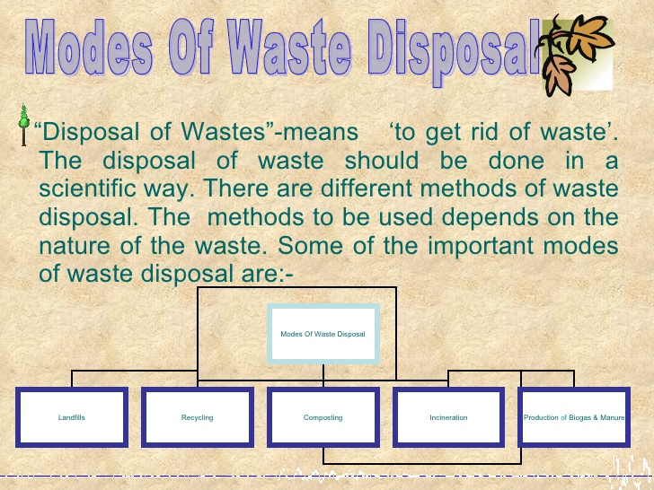

Slide 63
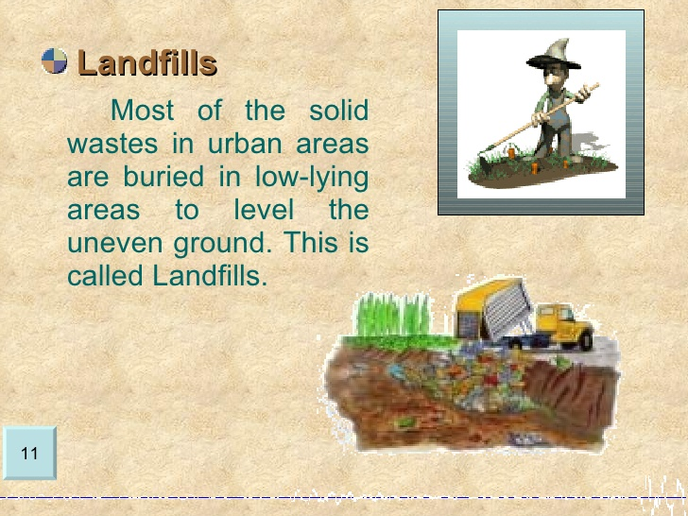

Slide 64
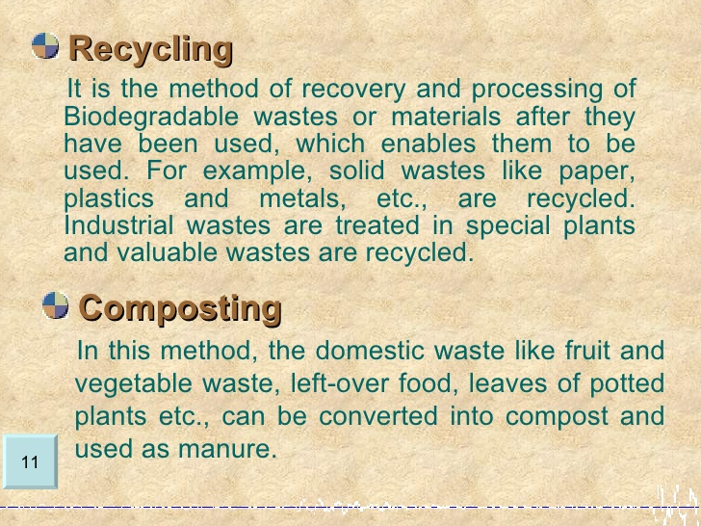

Slide 65
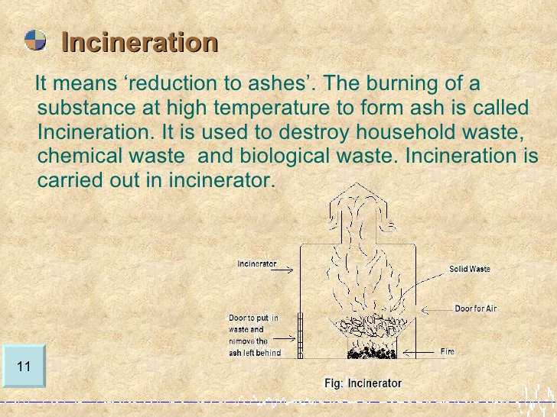

Slide 66
