Slide 1
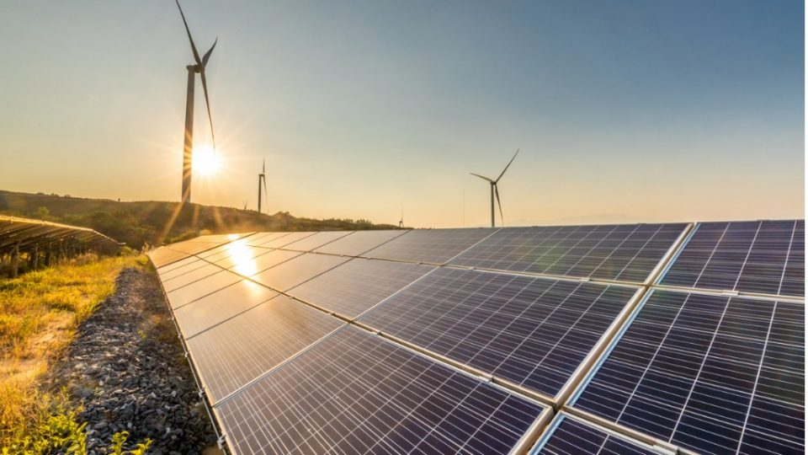
UNIT 3
ENERGY RESOURCES, THEIR USES, ALTERNATIVES AND ENVIRONMENTAL IMPACT
APARAJITA MUKHERJEE
THK JAIN COLLEGE

Slide 2
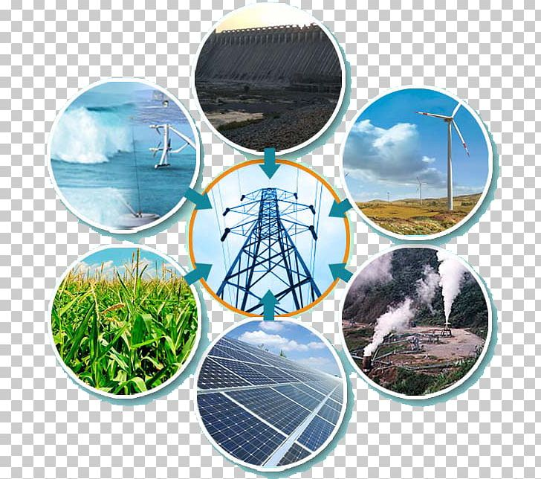
World energy resources
World energy resources are the estimated maximum capacity for energy production given all available resources on Earth.
An energy resource is something that can produce heat, power life, move objects, or produce electricity.
Matter that stores energy is called a fuel.

Slide 3
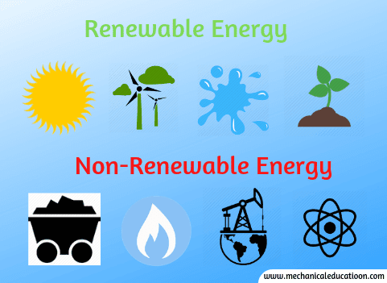
TYPES:
Energy resources are broadly classified into:
1. Non Renewable resources
2. Renewable resources

Slide 4
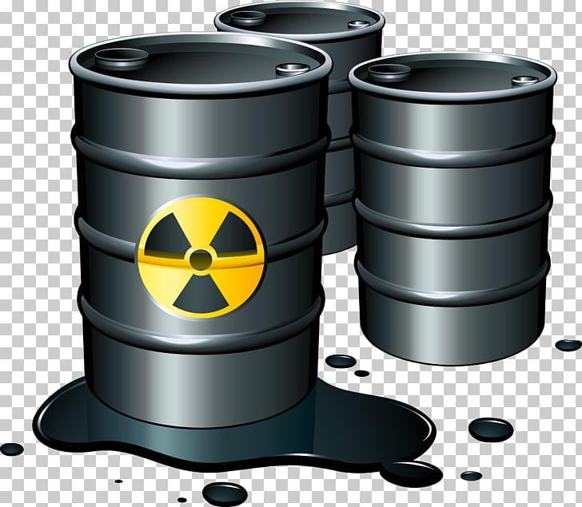
1. Non Renewable Resources
A non-renewable resource is a natural resource that cannot be readily replaced by natural means at human time scale, rather they can take thousands of years to build up. Such as:
a. Fossil fuel
b. Nuclear energy
c. Minerals

Slide 5
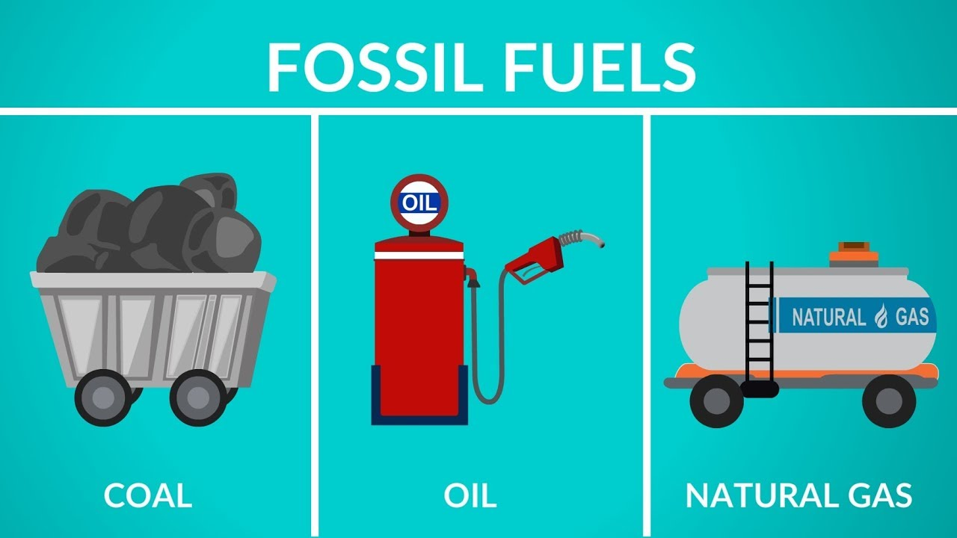
a. Fossil fuels
A fossil fuel is a fuel formed by natural processes, such as anaerobic decomposition of buried dead organisms, containing energy originating in ancient photosynthesis. Such organisms and their resulting fossil fuels typically have an age of millions of years.
Different types of fossil fuels are hereby discussed:

Slide 6
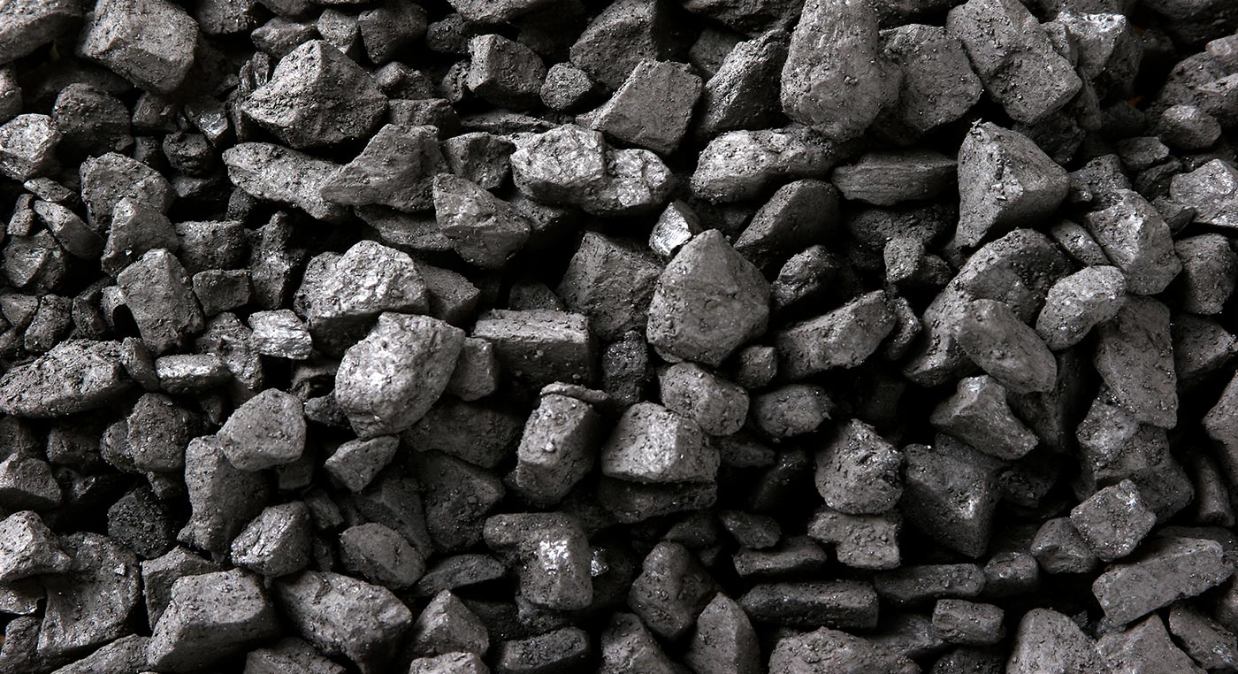
Coal
Coal is the most abundant and burned fossil fuel. This was the fuel that launched the industrial revolution and has continued to grow in use.
Coal is the fastest growing fossil fuel and its large reserves would make it a popular candidate to meet the energy demand of the global community
According to the International Energy Agency the proven reserves of coal are around 909 billion tonnes, which could sustain the current production rate for 155 years, although at a 5% growth per annum this would be reduced to 45 years, or until 2051.

Slide 7
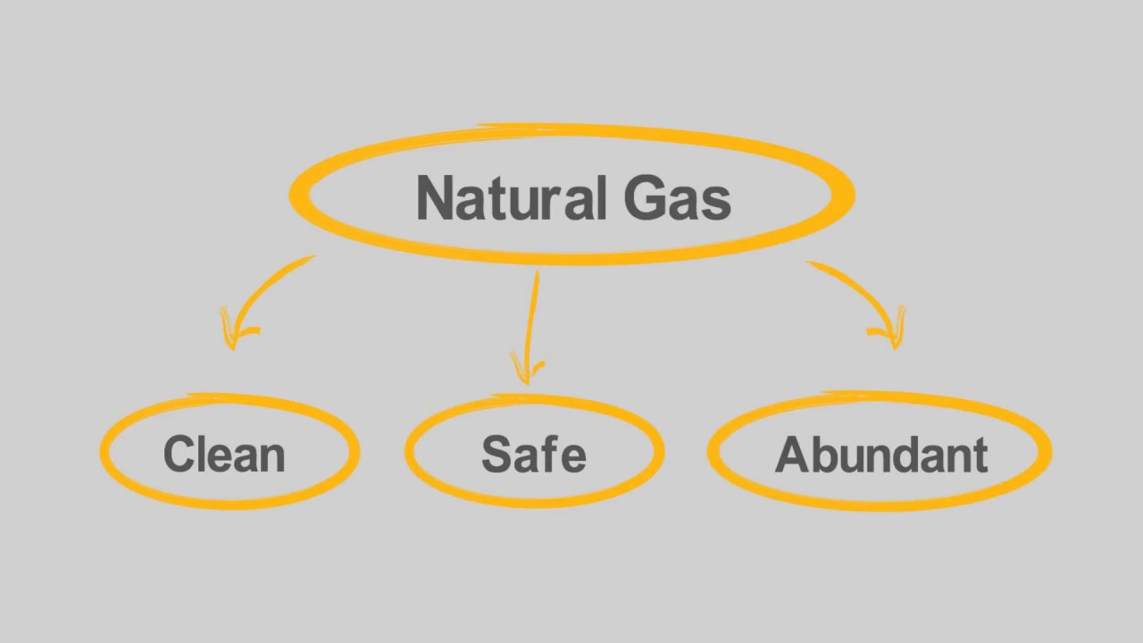
Natural gas
Natural gas (also called fossil gas) is a naturally occurring hydrocarbon gas mixture consisting primarily of methane, but commonly including varying amounts of other higher alkanes, and sometimes a small percentage of carbon dioxide, nitrogen, hydrogen sulfide, or helium.
It is formed when layers of decomposing plant and animal matter are exposed to intense heat and pressure under the surface of the Earth over millions of years.
Natural gas is a non-renewable hydrocarbon used as a source of energy for heating, cooking, and electricity generation. It is also used as a fuel for vehicles and as a chemical feedstock in the manufacture of plastics and other commercially important organic chemicals.
At present usage rates, natural gas could supply most of the world's energy needs for between 100 and 250 years, depending on increase in consumption over time.

Slide 8

Oil
Crude oil is a naturally occurring, yellowish-black liquid found in geological formations beneath the Earth's surface. It is commonly refined into various types of fuels.
Components of petroleum are separated using a technique called fractional distillation.
Crude oil or petroleum is formed when large quantities of dead organisms, mostly zooplankton and algae, are buried underneath sedimentary rock and subjected to both intense heat and pressure.
Extensive extraction has made this valuable resource very scarce.
Some estimate that, assuming current consumption rates, current oil reserves could be completely depleted by 2050.

Slide 9

b. Nuclear energy
Nuclear fuel is material used in nuclear power stations to produce heat to power turbines. Heat is created when nuclear fuel undergoes nuclear fission.
Most nuclear fuels contain heavy radioactive elements that are capable of undergoing and sustaining nuclear fission. The three most relevant isotopes are Uranium-233, Uranium-235 and Plutonium-239.
Not all types of nuclear fuels create power from nuclear fission; plutonium-238 and some other elements are used to produce small amounts of nuclear power by radioactive decay.

Slide 10
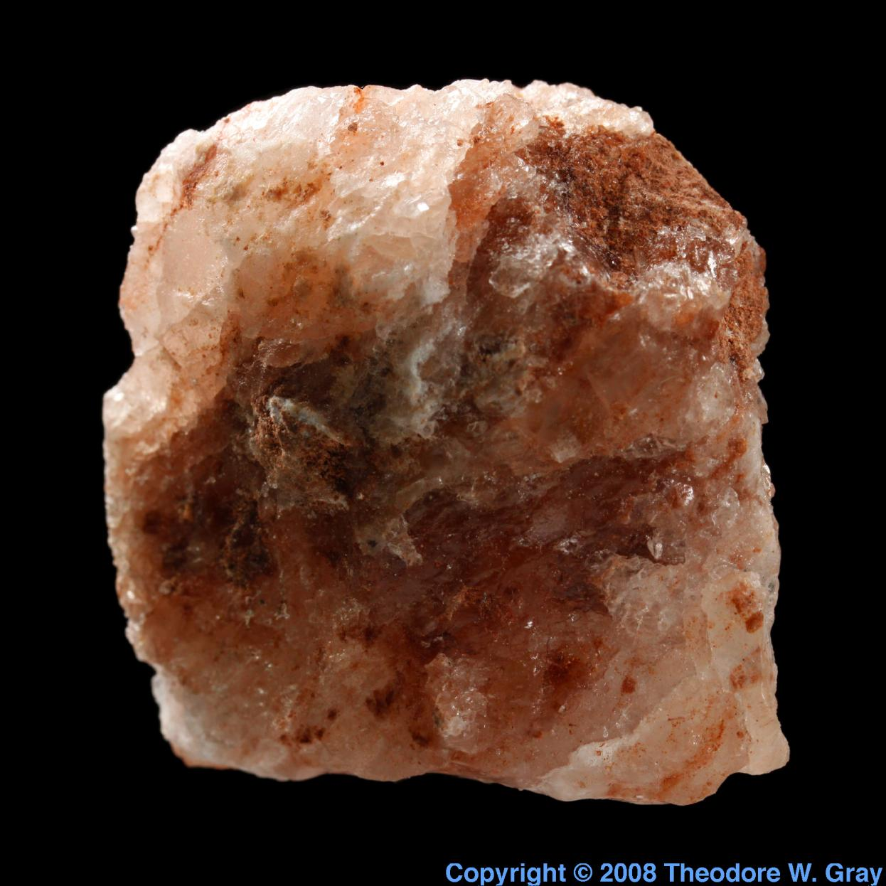
c. Minerals
Minerals are solid substances that are present in nature and can be made of one element or more elements combined together (chemical compounds). For examples: Different metals (iron, copper, gold) and non metals (carbon, mica) etc.
All minerals are non renewable resources.

Slide 11

2. Renewable resources
A renewable resource is a natural resource which will restore to replace the portion depleted by usage and consumption, either through natural reproduction or other recurring processes in a finite amount of time in a human time scale.
These include:
solar energy
wind energy
geothermal energy
hydropower
Biomass energy

Slide 12
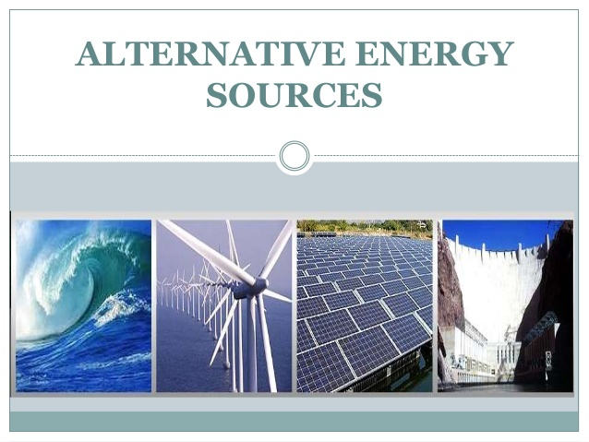
These are also called Alternative sources of energy
Alternative energy sources are renewable and are thought to be "free" energy sources. They all have lower carbon emissions, compared to conventional energy sources.
These include:
Solar energy
Wind energy
Hydro power
Tidal energy
Geothermal energy
Biomass energy

Slide 13
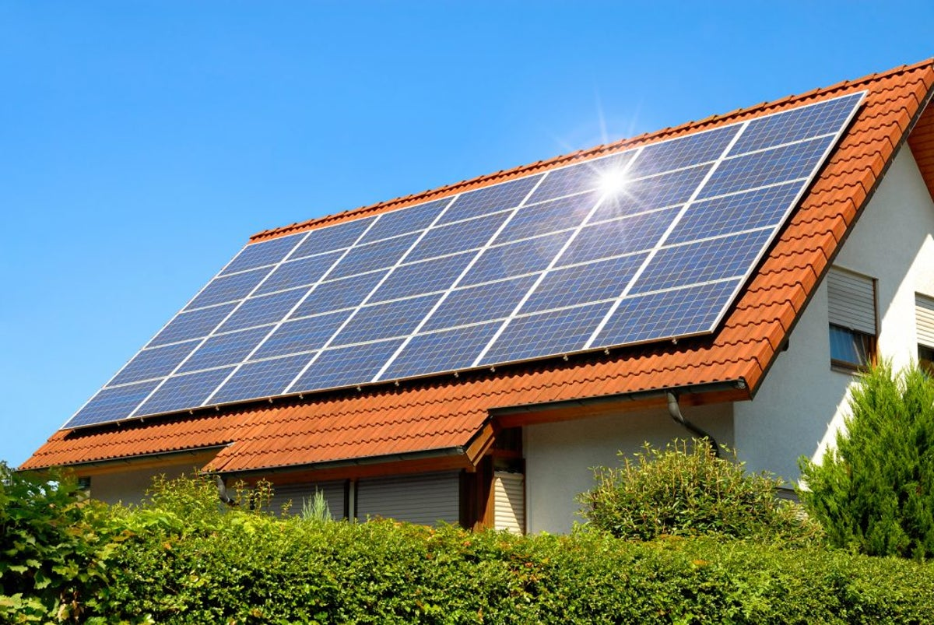
Solar energy
Solar energy is radiant light and heat from the Sun that is harnessed using a range of ever-evolving technologies such as solar heating, photovoltaic, solar thermal energy, solar architecture, molten salt power plants and artificial photosynthesis
It is an essential source of renewable energy
Globally, solar generation is the fastest growing source of energy, seeing an annual average growth of 35% over the past few years.
Japan, Europe, China, U.S. and India are the major growing investors in solar energy.

Slide 14
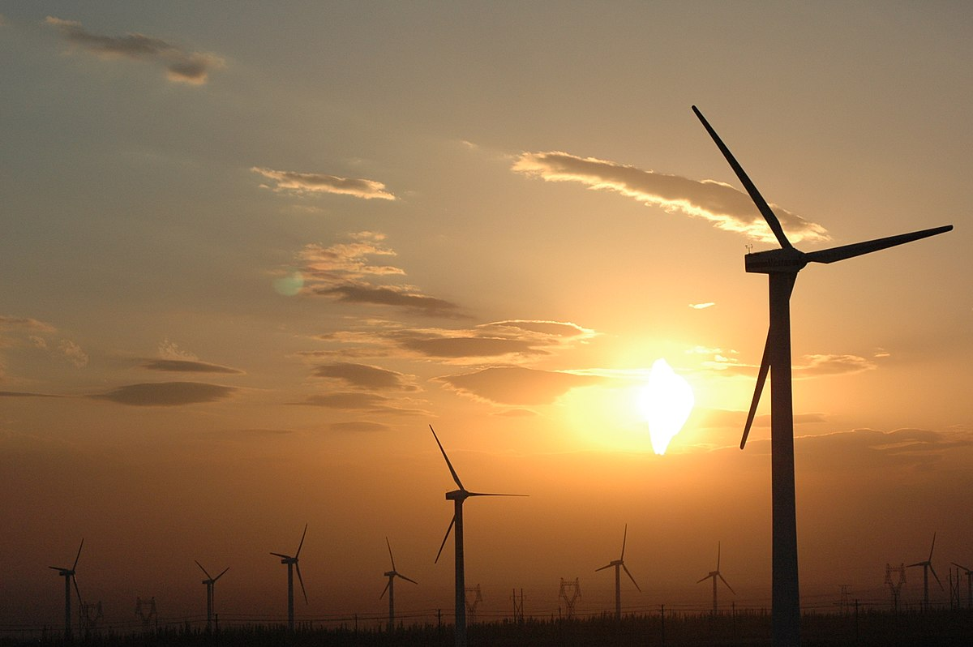
Wind energy
Wind power or wind energy is the use of wind to provide the mechanical power through wind turbines to turn electric generators and traditionally to do other work, like milling or pumping.
Wind power is a sustainable and renewable energy
It has a much smaller impact on the environment compared to burning fossil fuels

Slide 15
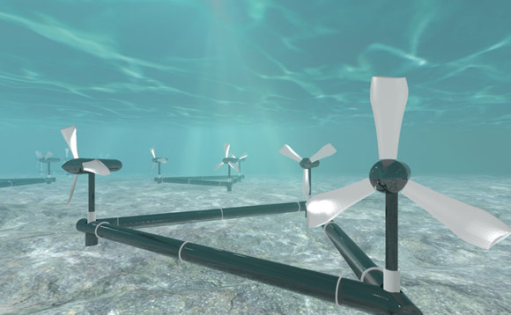
Tidal energy
Tidal power or tidal energy is the form of hydropower that converts the energy obtained from tides into useful forms of power, mainly electricity.
Although not yet widely used, tidal energy has the potential for future electricity generation.
Tides are more predictable than the wind and the sun.
Among sources of renewable energy tidal energy has traditionally suffered from relatively high cost and limited availability of sites with sufficiently high tidal ranges or flow velocities, thus constricting its total availability

Slide 16
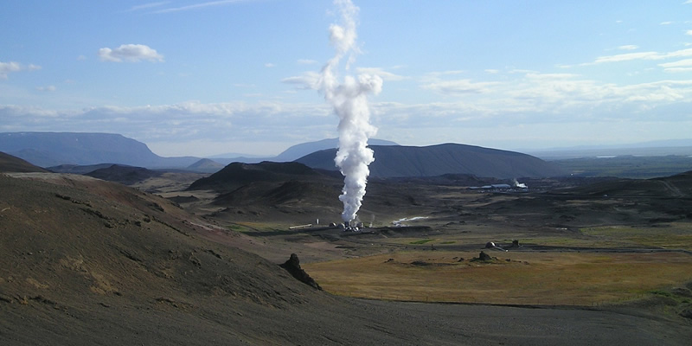
Geothermal energy
Geothermal energy is thermal energy generated and stored in the Earth. Thermal energy is the energy that determines the temperature of matter. The geothermal energy of the Earth's crust originates from the original formation of the planet and from radioactive decay of materials
Geothermal power is power generated by geothermal energy. Technologies in use include dry steam power stations, flash steam power stations and binary cycle power stations.
As of 2015, worldwide geothermal power capacity amounts to 12.8 gigawatts (GW), of which 28 percent or 3.55 GW are installed in the United States.

Slide 17
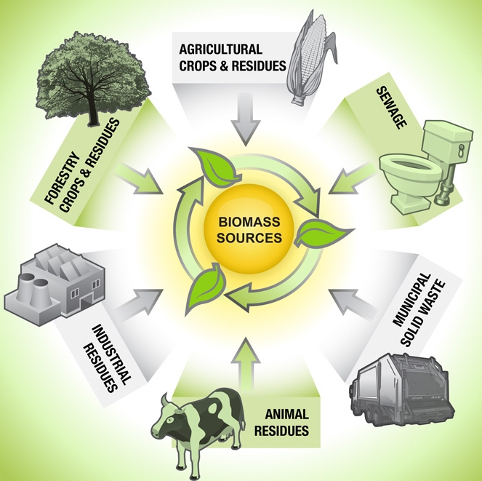
Biomass energy
Biomass is plant or animal material used for energy production (electricity or heat), or in various industrial processes as raw substance for a range of products.
As every living organism dies for sure, biomass production is evident. And if that can be used anyhow for the human benefit, what can be better than that!
It can be purposely grown energy crops, or obviously can be wood or forest residues, waste from food crops (wheat straw), horticulture (yard waste), food processing (corn cobs), animal farming (manure, rich in nitrogen and phosphorus), or human waste from sewage plants.
Burning plant-derived biomass releases CO₂. However, it has still been classified as a renewable energy source.

Slide 18
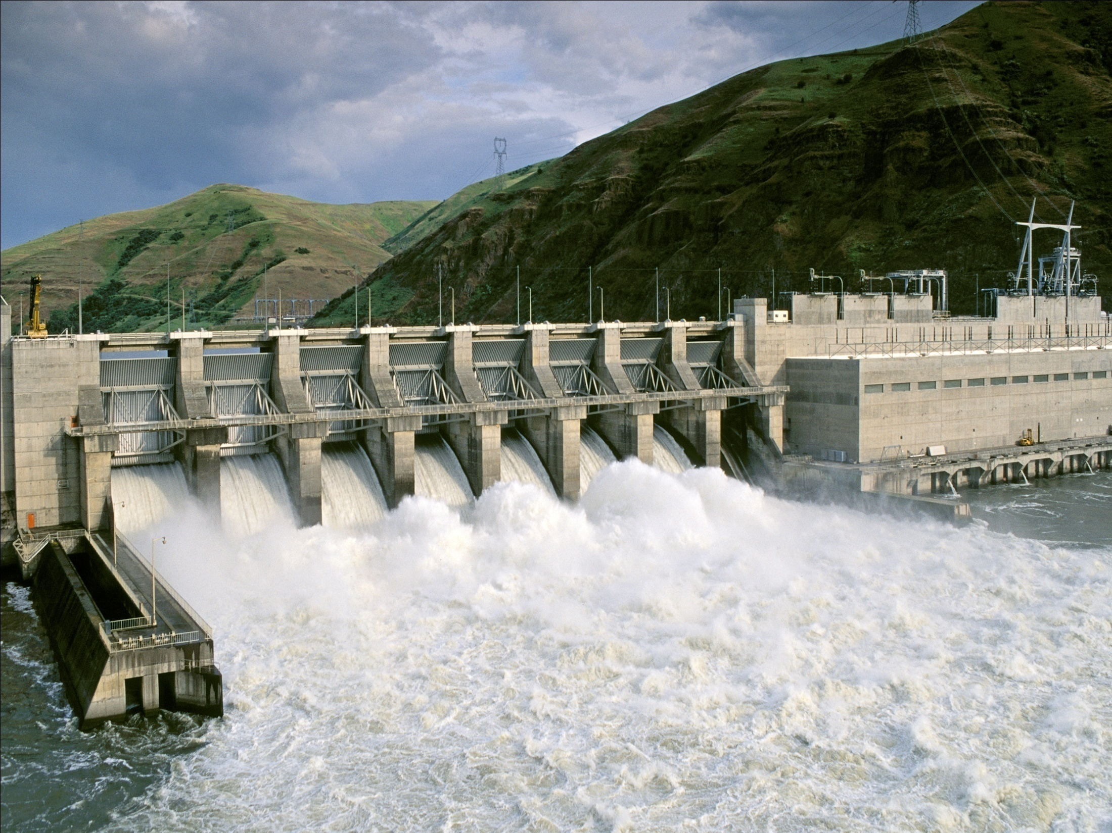
Hydropower
Hydropower or water power is power derived from the energy of falling or fast-running water, which may be harnessed for useful purposes. Since ancient times, hydropower from many kinds of watermills has been used as a renewable energy source.
In the late 19th century, hydropower became a source for generating electricity
the first commercial hydroelectric power plant was built at Niagara Falls in 1879. In 1881, street lamps in the city of Niagara Falls were powered by hydropower.
Since the early 20th century, the term has been used almost exclusively in conjunction with the modern development of hydroelectric power.
Hydropower ensures economic development without adding substantial amounts of carbon to the atmosphere
But dams can have significant negative social and environmental impacts

Slide 19

Global growing energy needs
Global demand for energy is predicted to increase in the coming decades.
The International Energy Agency’s 2007 World Energy Outlook states that between now and 2030:
Between 2005 and 2030, energy needs are projected to expand by 55 per cent, with demand increasing from 11.4 billion tons of oil equivalent to 17.7 billion.
Between 2005 and 2030, energy consumption is expected to increase by 50 per cent, with the bulk of the demand coming from developing countries.
Oil, coal and gas together account for the majority of global primary energy consumption.

Slide 20
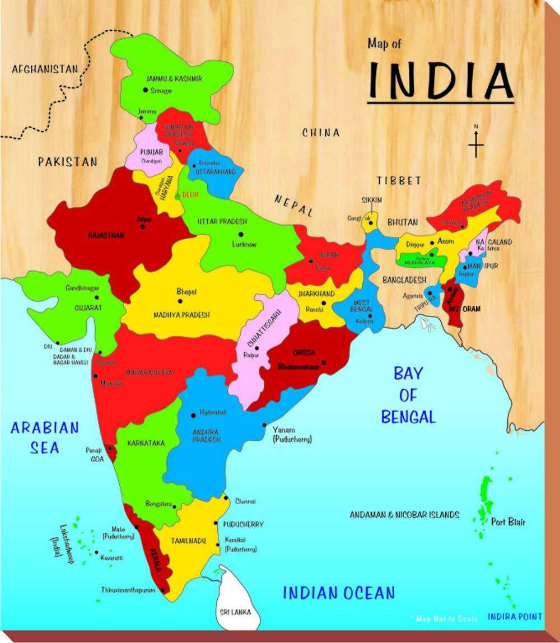
growing energy needs in India
India, the second largest populated nation in the world with more than a billion people has an economy which is growing at nearly 8% over the last decade and about 6% on the average since her independence in 1947.
This is also highlighted by the fact that globally, the nations with improved quality of life, as reflected by the larger value of the human development index, consume more amount of energy per capita.
Though India is presently the fourth largest electricity producing country in the world, her per capita energy consumption (500 kWh) is rather small, which is only about 1/2 of China , 1/4 of World average and about 1/13th of developed nations.
However, India aspires to reach at least the global average by 2050, which would require her to produce about 1300 GW of electricity, ten times more than the present value of about 130 GW. Of the present electricity generation, about 80% of the resources is fossil fuels. Hydro about 15%, renewable about 2% and nuclear about 3%.

Slide 21
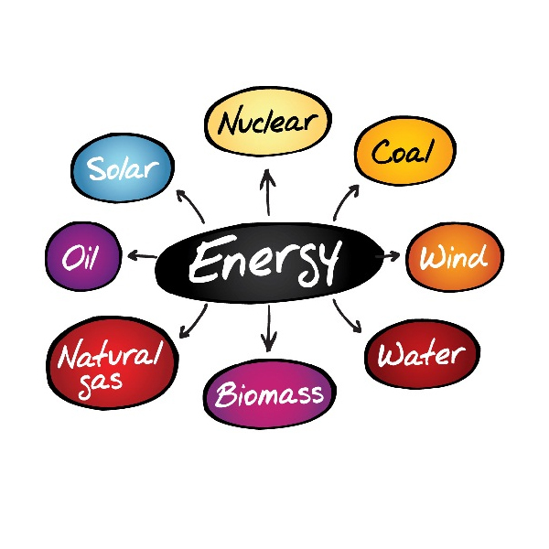
MAKE WISE USE!

Slide 22

THANK YOU

