Slide 1
COMPUTERISED ACCOUNTING SYSTEM and E-FILLING OF TAX RETURN 6TH SEMESTER UNIT-2 DESIGNING COMPUTERISED ACCOUNTING SYSTEM (DBMS PACKAGE)
Prepared by RAJA APUL

Slide 2
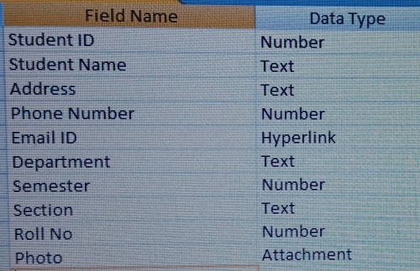
Here are the steps that you’ll need to take in order to create Data Base:
(1) The first obvious step that you’ll need to do is to open MS Access
(2) Choose the option of a Blank database
(3) Type your desired File Name for your new database (ex: THK Jain College) and click on ‘Create’.
Here are the steps to Create Table:
Click on ‘View’
Select ‘Design View’
Type your desired table name (ex: Students Information) then click on ‘Ok’
Fill the desired fields accordingly and Save it
Now filled the table accordingly and save it

Slide 3
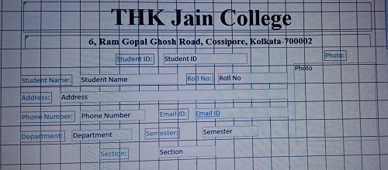
Here are the steps to create and design Form:
After completion of the ‘Table’ click on ‘Create’
Click on ‘Form Design’
Click on ‘Add Existing Fields’
Design your form accordingly by double clicking all the fields and you can drag the fields and choose position
Save it
Click on ‘View’ and select ‘Form View’ and then you can check all the forms

Slide 4
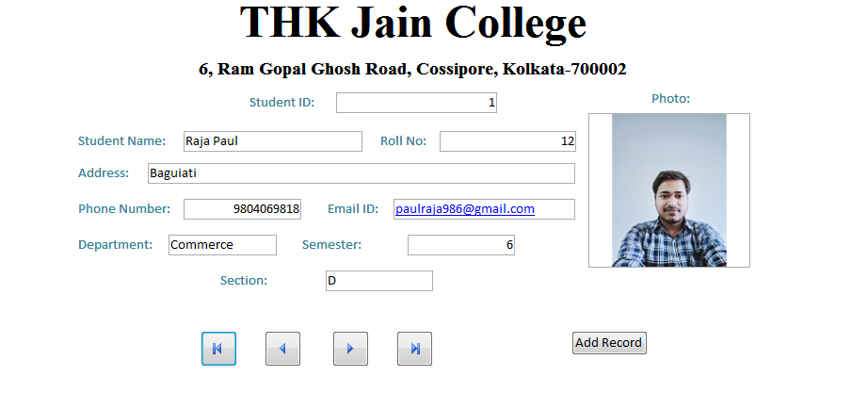
Here are the steps to Add Buttons on the Form:
Go to Form Design
Click on ‘Button’
Drag the Button to the desired position and click once
Click on ‘Record Navigation’
Click on ‘Go to First Record’; ‘Go to Previous Record’; ‘Go to Next Record’; ‘ Go to Last Record’
Click on ‘Next’
Select Picture or Text
Click on ‘Next’
Click on ‘Finish’
(Create four buttons one by one through the above mentioned steps)
Add another button by the following steps:
Go to Form Design
Click on ‘Button’
Drag the Button to the desired position and click once
Click on ‘Record Operation’
Click on ‘Add New Record’
Click on ‘Next’
Select Picture or Text
Click on ‘Next’
Click on ‘Finish’
After Completion the Form would be like this:

Slide 5
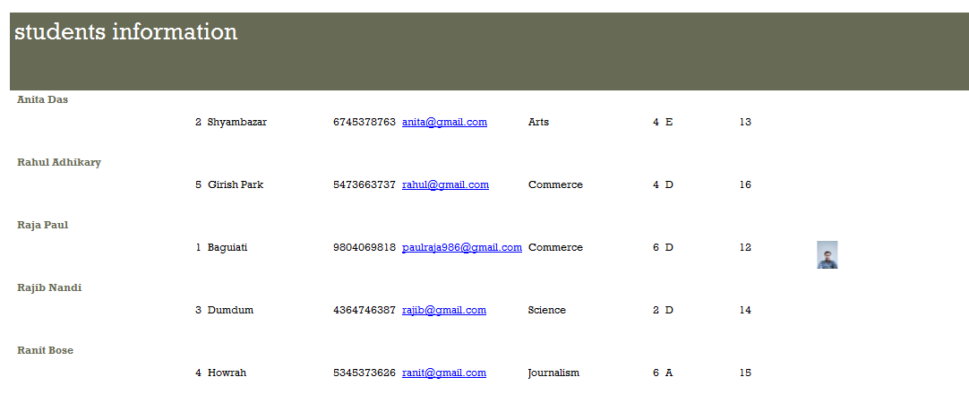
Here are the steps for Creating Report:
Click on ‘Create’
Click on ‘Report Wizard’
Select the Table
Select Desired Fields
Click on ‘Next’
Choose the Priority Column by double click (which will be shown at the top)
Click on ‘Next’
Choose the Ascending Field
Click on ‘Next’
Choose ‘Layout as Stepped’ and ‘Orientation as Landscape’
Click on ‘Next’
Click on ‘Foundry’
Click on ‘Next’
Select ‘Modify the Report’s Design’
Click on ‘Finish’
Adjust your Report
Click on ‘View’ and then Click on ‘Report View’

Slide 6
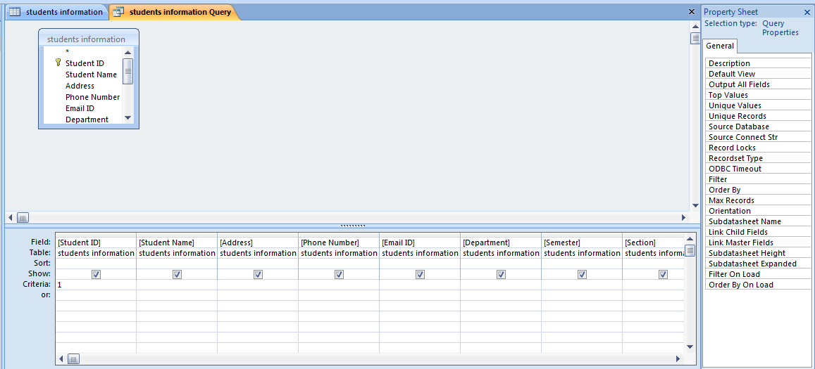
Here the steps to create Query and Run Query:
Click on ‘Create’
Click on ‘Query Wizard’
Select ‘Simple Query Wizard’
Click on ‘Ok’
Select the Desired Table
Choose Desired Fields
Click on ‘Next’
Choose ‘Detail (shows every field of every record)’
Click on ‘Next’
Click on ‘Modify the Query Design’
Click on ‘Finish’
The selected table will appear as a small window in the Object Relationship pane. In the table window, double-click the field names you want to include in your query. They will be added to the design grid in the bottom part of the screen
Set the search criteria by clicking the cell in the Criteria: row of each field you want to filter. Typing criteria into more than one field in the Criteria: row will set your query to include only results that meet all criteria. If you want to set multiple criteria but don't need the records shown in your results to meet all of them, type the first criteria in the Criteria: row and additional criteria in the or: row and the rows beneath it
After you have set your criteria, run the query by clicking the Run command
The query results will be displayed in the query's Datasheet view, which looks like a table. If you want, save your query by clicking the Save command in the Quick Access Toolbar. When prompted to name it, type the desired name, then click OK

Slide 7
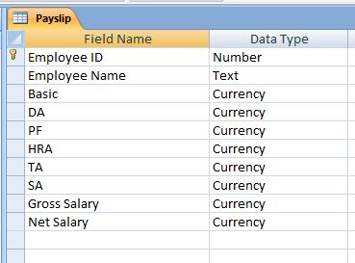
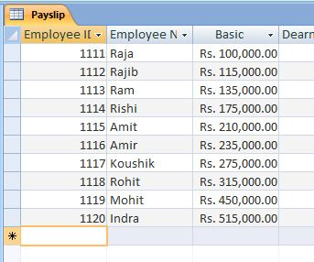
Steps to Create Pay-slip in MS Access:
The first obvious step that you’ll need to do is to open MS Access
Choose the option of a Blank database
Type your desired File Name for your new database (ex: Payroll) and click on ‘Create’
Create a table named as Pay-slip
(DA=Dearness Allowance; PF=Provident Fund; HRA=House Rent Allowance; TA=Travelling Allowance; SA=Special Allowance)
Fill the First Three Columns

Slide 8
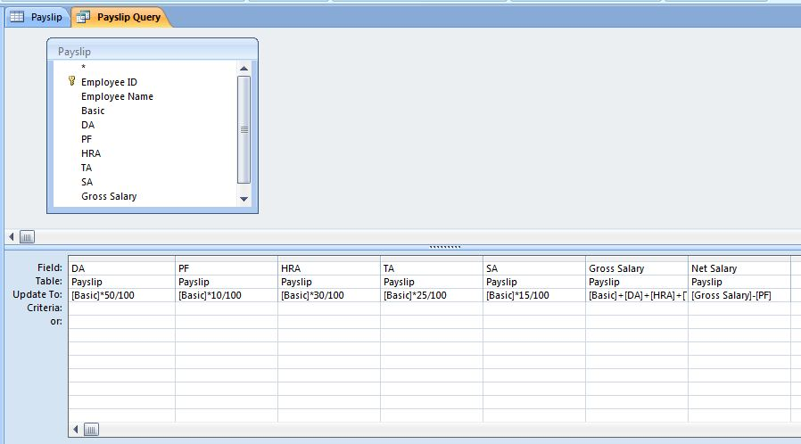
Click on ‘Create’
Click on ‘Query Design’
Add the Appropriate Table
Click on ‘Update’ under ‘Design’ head
Fill the ‘Field’ row and ‘Update to’ row each Boxes Accordingly
Click on ‘Update’ once and on the ‘Run!’ Button Twice
Then go to the Table and check all the Columns are filled accordingly or not. If not, the go to the Query and click on the ‘Run!’ button again

Slide 10
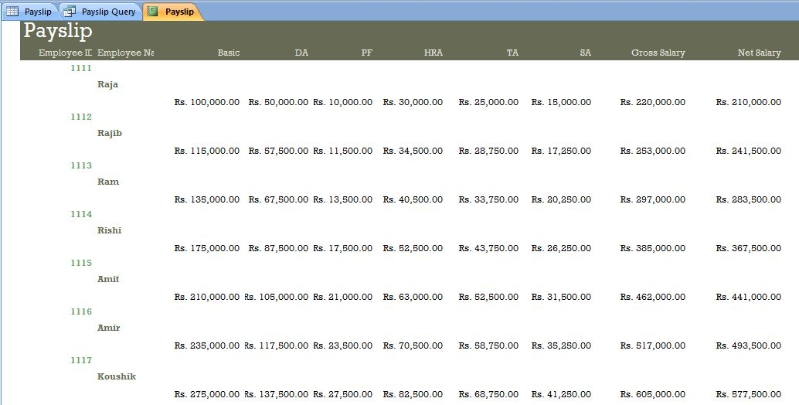
Create Pay Sheet Details through ‘Report Wizard’

Slide 11
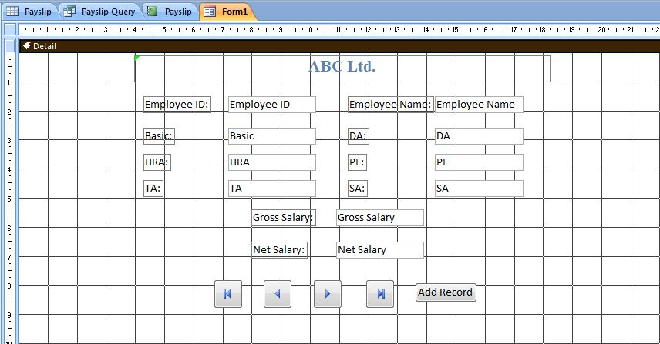
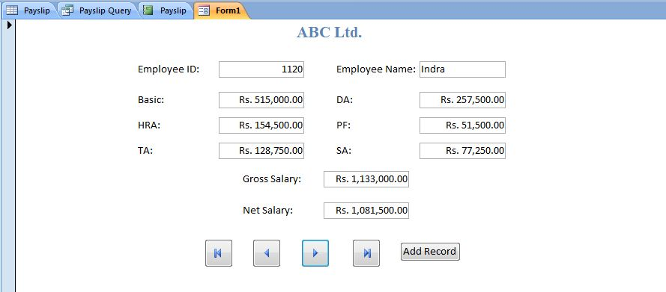
Create a Form to Enter data through ‘Form Design’

Slide 12
THANK YOU FOR WATCHING MY PRESENTATION

