Slide 1
HUMAN RESOURCE MANAGEMENT
UNIT 5: Job Analysis
By Prof. CHAITALI GHOSH
THK JAIN COLLEGE
Class- B.Com (Hons)
Semester 2, Sec-2E

Slide 2
Job Analysis
Job analysis is the basis for all HR activities. Job analysis provides information about what the job entails and what characteristics are required in an employee to carry out these activities. Job analysis is also known as work analysis.
Job analysis can be carried out by:
Direct observation of employees performing the work
Finding out information from interviewing job holders
Referring to the documents like training manuals
Training records
Performance appraisal or review reports
Questioning directly the person carrying out a task
Form their supervisory staff

Slide 3
Importance of Job Analysis
Job Analysis plays an important role in recruitment and selection, job evaluation, job designing, deciding compensation and benefits packages, performance appraisal, analyzing training and development needs, assessing the worth of a job and increasing personnel as well as organizational productivity.

Slide 5
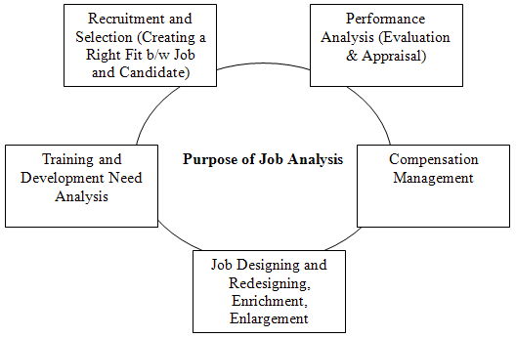

Slide 6
Products of Job Analysis
Job analysis yields multiple products, out of which the most important are job description and job specification. So, products of job analysis are:-
Job description
Job specification
Job classification
Job design/ structuring
Job evaluation
Performance appraisal
Training and development
Succession planning
Improving efficiency
Safety
Human resource planning
Legal and quasi-legal requirements

Slide 7
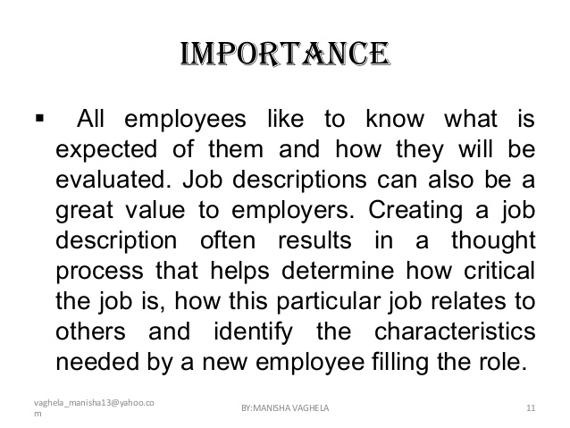
Job Description
A job description or JD is a written narrative that describes the general tasks, or other related duties, and responsibilities of a position. It may specify the functionary to whom the position reports, specifications such as the qualifications or skills needed by the person in the job, information about the equipment, tools and work aids used, working conditions, physical demands, and a salary range.

Slide 8
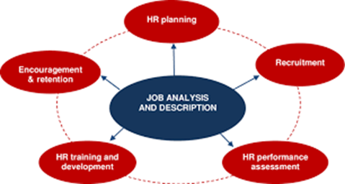

Slide 9
THANK YOU

