Slide 1
Cost and Management Accounting-II
4th Semester
Unit-4
Marginal Costing and CVP Analysis
Prepared by RAJA PAUL

Slide 2
Marginal Costing and CVP Analysis
Formulae:

Slide 3
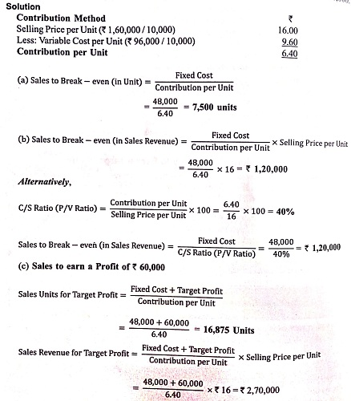
From the following information you’re required to calculate:
Sales to break-even in unit
Sales to break-even in sales revenue
Sales to earn a profit of Rs. 60000.
Additional information:
(i) Sales (10000 units) Rs. 160000; (ii)Variables cost Rs. 96000; (iii)Fixed cost Rs. 480000

Slide 4
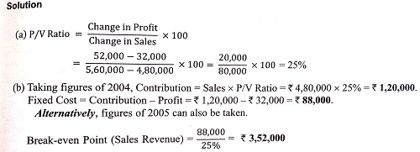
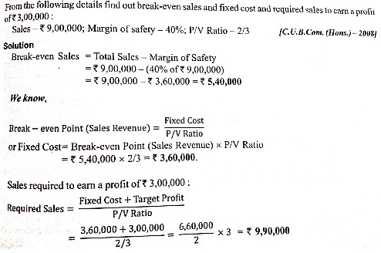
2.
3.

Slide 5
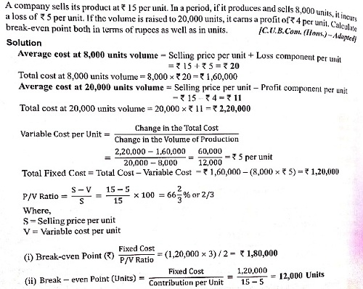
4.
5.

Slide 6
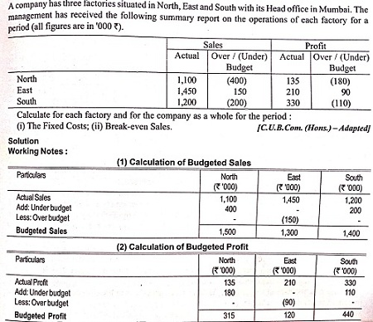
6.
Continue

Slide 7
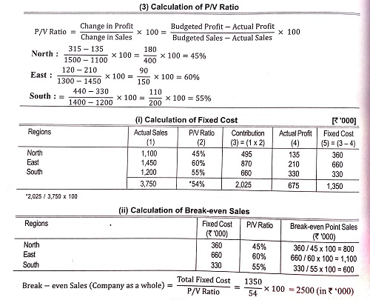

Slide 8
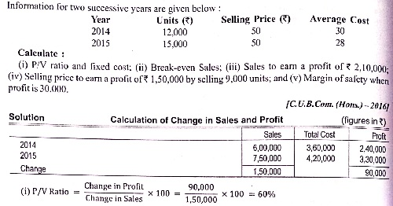
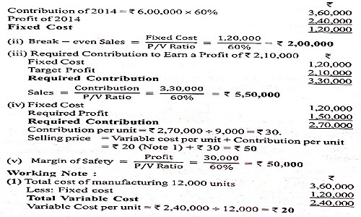
7.

Slide 9
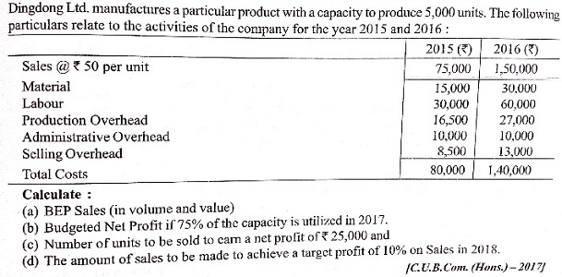
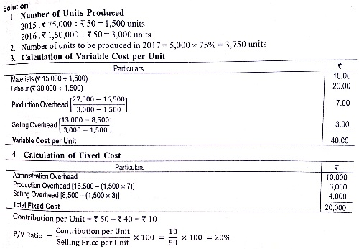
8.
Continue

Slide 10
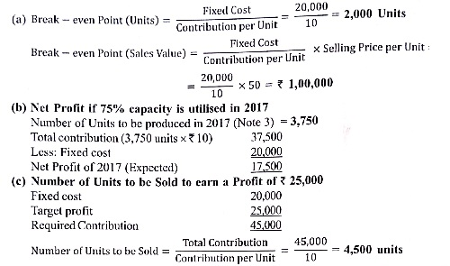
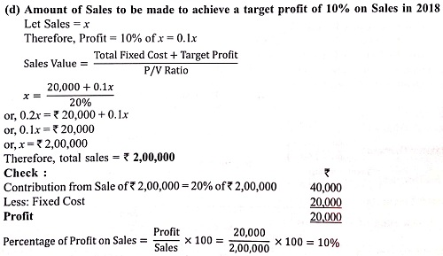

Slide 11
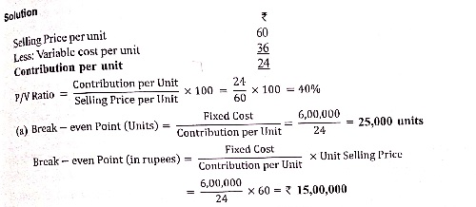
9.
Continue

Slide 12
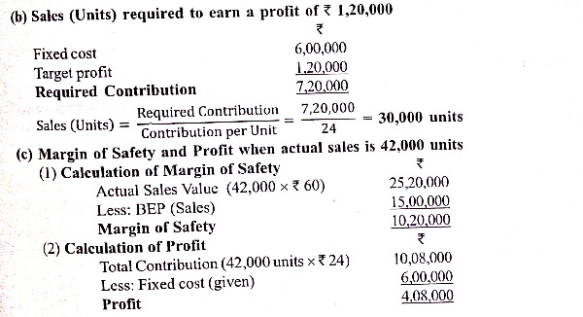
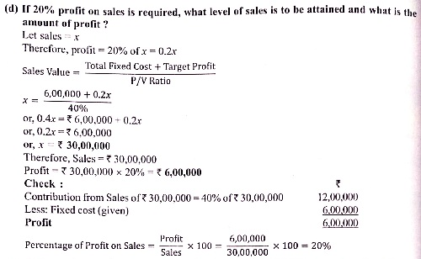
Continue

Slide 13
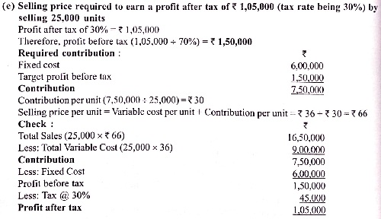
THANK YOU FOR WATCHING MY PRESENTATION

