Slide 1
HUMAN RESOURCE MANAGEMENT
UNIT 2: Human Resource Planning (part 2)
By Prof. CHAITALI GHOSH
THK JAIN COLLEGE
Class- B.Com (Hons)
Semester 2, Sec-2E

Slide 2
Approaches of HRP
Social demand approach
SDA relies on the assessment of society’s requirement of education. It depends on seven aspects:
Income of educated people
Tastes and preferences of households for education
Preferences of domestic circles for education
Demographic characteristics such as fertility and mortality
Direct cost of education
Students grants
Existing standards of entrance to institutes

Slide 3
2. Rate of return approach
RRA is a critic of social demand approach. As per this approach, after passing the school-leaning age, people attach positive values to present and future benefits of education, and their careers on consideration.
The three parameters are:--
Cost of education
Return to education
Present net worth (used in discounting future return to arrive at present value)
Three categories:--
Direct monetary benefits
Indirect monetary benefits
Non-monetary benefits

Slide 4
3. Manpower requirement approach
MRA rests on the maxim or axiom that a definite link exists between education and economic growth, and lack of skilled manpower hinders the growth of any nation.
Basic steps:--
Anticipating the direction and magnitude of development of each individual sector in the economy
Evolving norms for engaging manpower in each individual sector duly considering the technological options, both present and future.
Translating physical targets for the development of manpower requirements using specific manpower norms
Estimating the educational equivalents of manpower requirements

Slide 5
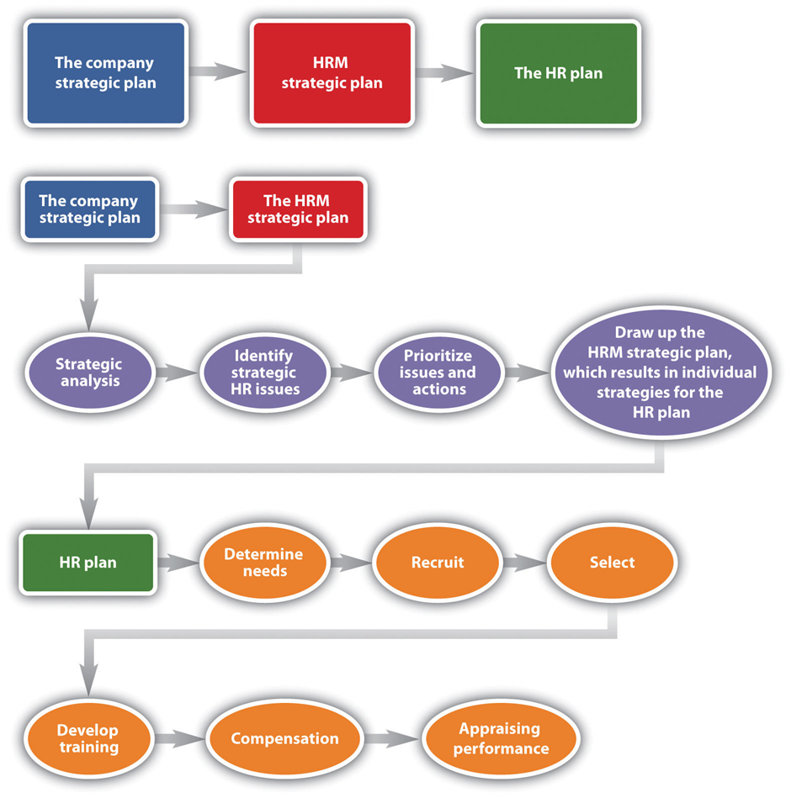

Slide 6
HRP Forecasting
Human resource forecasting is the prediction of future levels of demand and supply of workforce at:
Organizational
Regional
National level
Types of Forecasting:
Short-term forecasts
Medium-term forecast
Long-term forecast
Policy conditional forecast
Onlookers forecast
Macro forecast
Micro forecast

Slide 7
Importance of Human Resource Planning
Key to managerial functions
Efficient utilization
Motivation
Better industrial relations
Higher productivity
Responsibility and Accountability

Slide 8
