Slide 1
B.COM SEMESTER –II MARKETING MANAGEMENT Chapter- Introduction (Continuation)
Bandana Sinha
Commerce Faculty
THK Jain College

Slide 2
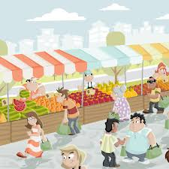
What is Market???
Traditionally, market was the place to buy & sell the products in a particular place.
In Modern definition, market is any area over which buyers and sellers are in close touch with one another, either directly or indirectly ,through dealers or not, that the price obtainable in one part of the market affects the price paid in another parts.

Slide 3
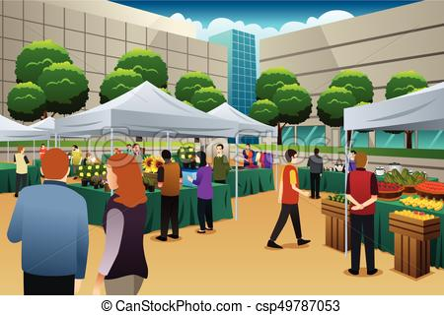
What is Marketing????
Flow of goods and services from producers to customers.
Consists of those activities involved in the flow of goods & services from the point of production to the point of consumption.
Finding out what people wants & creating products, services or ideas that match those needs.

Slide 4
Market & Marketing total demand of potential buyer all activities aimed at customer satisfaction. Places or area ( covers exchange functions) where buying & selling take place other facilitating functions( financing, risk, bearing, after sales services etc.

Slide 5
Nature Of Marketing
It is a legal process by which ownership is transferred.
It is a system of interacting business activities
It is a managerial function of organizing and directing business activities that facilitates the movement of goods from producer to customers.
It is a philosophy based on consumer orientation and satisfaction.
It has dual objectives- Profit Making & Consumer Satisfaction.

Slide 6
Old concept of Marketing
Sales
Profit through Sales
Goods & Services

Slide 7
New concepts Of Marketing
Discovery Of customer Needs
Production Of Goods & Services
Sales
Creation of Demand
After Sales Services
Profit through Customer Satisfaction

Slide 8
Modern Marketing
Every employee is a Marketer
Internal Communication
Experience Concept
Green Marketing

Slide 9
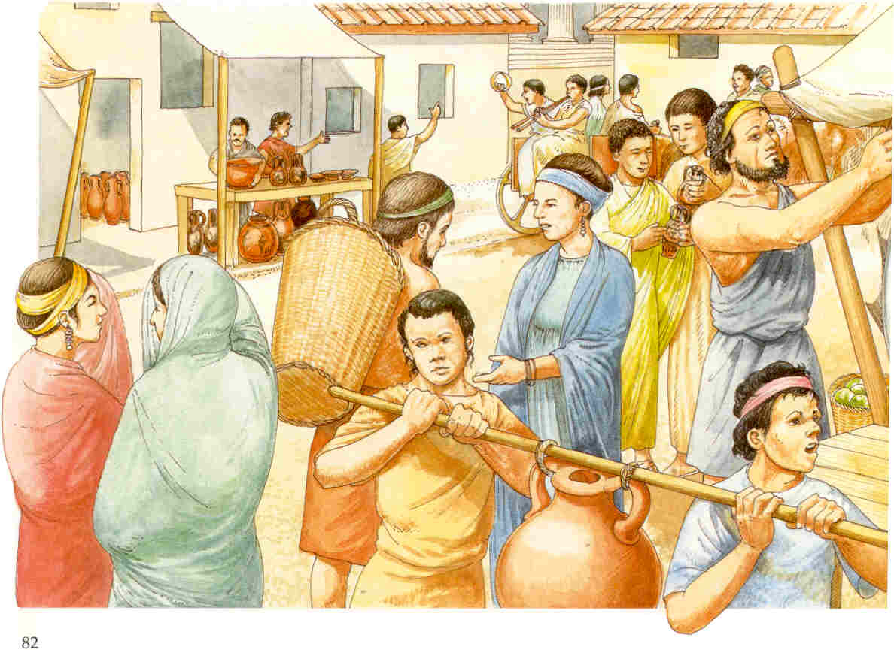
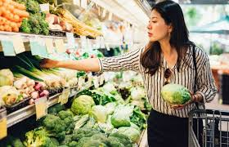
Marketing Concepts
Production Concept
Service Concept
Selling Concept
Marketing Concept
Societal Market Concept
Holistic Concept
Internal Marketing
Integrated Marketing
Relationship Marketing
Performance Marketing

Slide 10
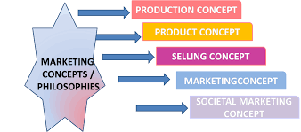

Slide 11
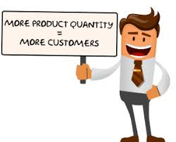
Production Concept
It is one of the oldest concept in business.
It holds that consumer will prefer products that are widely available and inexpensive.

Slide 12
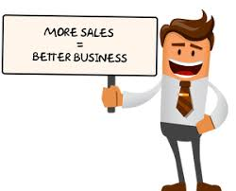
Selling Concept
It holds that the consumer and businesses, if left alone, won’t buy enough of the organization’s product.
The organization must therefore undertake an aggressive selling and promotion effort.

Slide 13
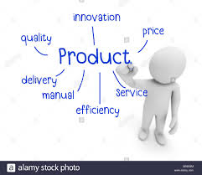
Product Concept
It proposes that consumers favour products that offers the most quality, performance, or innovative features.
Managers in these organization focus on marketing superior products and improving them.

Slide 14
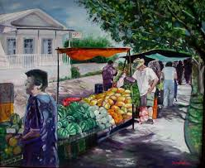
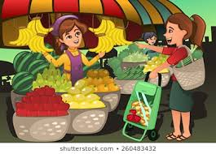
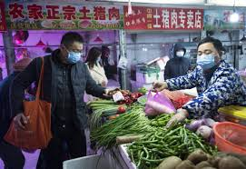
Marketing Concept
It emerged in mid-1950s, instead of a product-centered, make and sell philosophy, business shifted to the customer-centered.
It focuses on the concept that design product according to the need of the customer for their satisfaction.

Slide 15
Holistic Marketing Concept
Holistic Marketing recognize that “everything matters” in marketing
Holistic marketing is an approach that attempts to recognize and reconcile the scope and complexities of marketing activities.

Slide 16
Factors Influencing Marketing Concept
Growth Of population
Changing Concept Of family
More disposable income
More discretionary Income
Technology Advancement
Media
Credit Facility

Slide 17
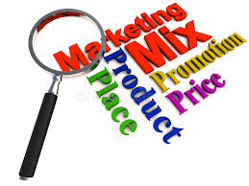
Marketing Mix
In the words of Philip Kotler, “ Marketing Mix is the set of Controllable Variable and their levels that the firms uses to influence the target market.”
The idea of marketing mix was conceived by Prof. Neil h Borden of the Harvard Business School.
It was James Culliton who for the first time used the term the Marketing Mix.
Later on, Jerome McCarthy , who used the coinage 4P of marketing mix in place of marketing mix.

Slide 18
4P
Product
Price
Place
Promotion

Slide 19
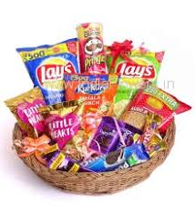
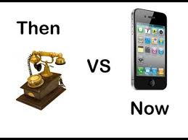
Product
It is the thing possessing utility.
It is the bundle of value the marketer offers to potential customers.
It has:
Portfolio( Width, Length & Depth)
Design, shape and Size
Package
Branding
Merchandising

Slide 20
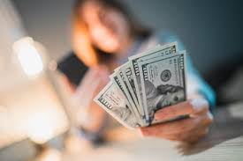
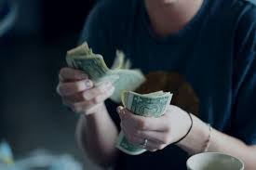
Price
It is the amount of money asked in exchange for product.
It must be reasonable so as to enable the consumer to pay for the product.
it must have:
Resale price maintenance
Pricing Strategies
Physical transportation

Slide 21
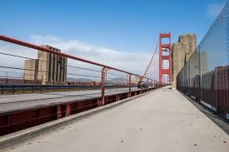
Place
It is the delivery of the product at the right time and at the right place.
It is the combination of decision regarding channel of distribution( wholesalers, retailers etc.) .
It must have:
Channel design and structure.
Logistics Management
Physical transportation.

Slide 22
Promotion
It consists of all activities aimed at including and motivating customers to buy the product .
The selection of alternatives determine the success of marketing efforts.
It includes:
Advertisement
Publicity
Personal Selling
Sales Promotion.

Slide 23
4C
Communication
Cost
convenience
Customer

Slide 24
4C & 4P
Customer
Product
Cost
Price
Convenience
Place
Communication
Promotion

Slide 25
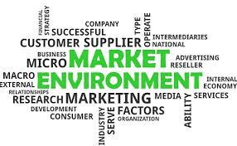
Marketing Environment
Marketing Environment is the combination of external and internal factors and forces which affect the company’s ability to establish a relationship and serve its customers.
The internal environment is company specific and somehow controllable & includes owners, workers, machines, materials etc.
The external environment constitutes factors and forces which are external to business and on which the marketer has little or no control.

Slide 26
Marketing Environment
Un-controllable
(External)
Micro
Macro
Controllable
(Internal)
-Marketing policies-Marketing strategies

Slide 27
Macro Environment refers to the larger societal forces that affect the micro environment.
Macro Environment
Technological
Natural
Political
Demographic
Economical
Social
Cultural
Ethical

Slide 28
Macro Environment refers to the factors close to the company that affects its ability to serve its customers.
Macro Environment
Marketing Intermediaries
Suppliers
Customer Markets
Public
Competitor

Slide 29
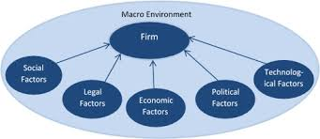
Macro Environment
The macro environment of the marketing environment is also known as broad environment. It constitutes the external forces and factors which affects the industry as a whole but don’t direct effect on the business .
They are:

Slide 30
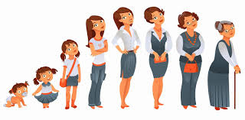
A. Demographic Environment
The demographic environment is made of the people who constitute the market.
It is characterized as the factual investigation and segregation of the population according to their size, density, location, age, gender, race and occupation.

Slide 31
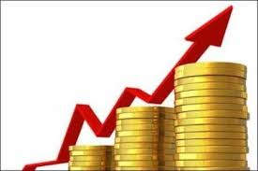
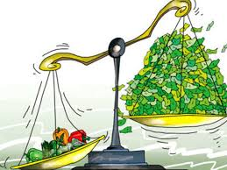
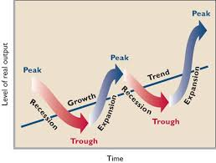
B. Economic Environment
The economic environment constitutes the factors which influence the purchasing power of the customers and their spending pattern.
These factors includes the GDP, GNP, Interest rates, inflation, income distribution, government funding & subsidies and other major economic variables.

Slide 32
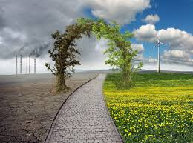
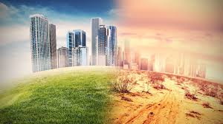
C. Physical Environment
The physical environment includes the business environment on which the business operate.
This includes the climate condition, environmental changes, accessibility to raw material & water , natural disasters, pollution etc.

Slide 33
D. Technological Environment
The technological environment consists of innovation, research & development in technology, technological alternatives.
Technology is the biggest source of threat and opportunities for the organization and it is very dynamic.

Slide 34
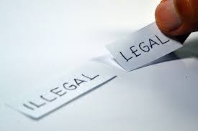
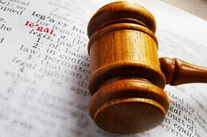
E. Political-legal Environment
The political & legal environment includes laws and government’s policies prevailing in the country.
It also includes the other pressure groups & agencies which influences or limit the working of the industry and/or the business in the society.

Slide 35
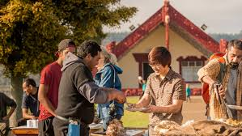
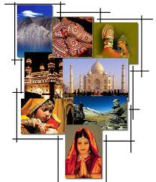
F. Social- Cultural Environment
The social-cultural environment aspect of the micro environment is made up of the life style, values, culture, prejudices and belief of the people.
This differs in different region.

Slide 36
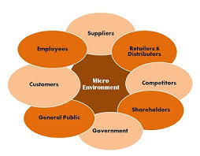
Micro Environment
The micro environment of the external environment is also known as the task environment.
It comprises of external forces and factors that are directly related to the business.
They are:

Slide 37
Suppliers: it includes all the parties who provides resources needed by the organization.
Market Intermediaries: it includes the parties involved in distributing the product or service of the organization.
Partners: they are all the separate entities like advertising agencies, market research organization, banking & insurance company, transportation company, broker etc. which conduct business with the organization.

Slide 38
Customers : It comprise of the target group of the organization.
Competitors: Competitors are the players in the same market who targets the similar customers as that of the organization.
Public: Public is made up of any other group that has an actual or potential interest or affects the company’s ability to serve its customers.

Slide 39
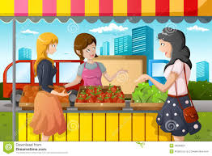
Concept Check
1) which concept of marketing is based on the assumption that superior products sell themselves?
a) production
b) marketing
c) product
d) Societal

Slide 40
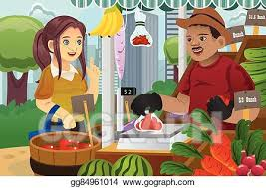
2) when the customers favour those products which offers the most quality, performances or innovative features, then it is called as:
A) Production concept
B) Product concept
C) Sales concept
D) Marketing Concept

Slide 41
3) The selling concept is most likely to be used by firms which sell:
A) Convenience goods
B) shopping goods
C) specialty goods
D) Unsought goods*(notes)
cont……..

Slide 42
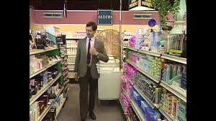
*Notes: unsought goods are those goods that the customers does not know about or does not normally think of buying, and the purchase of which arises due to danger or the fear of danger and lack of desire.
The classic example of known but unsought goods are LIC, encyclopedias, fire extinguishers , reference book etc.

Slide 43
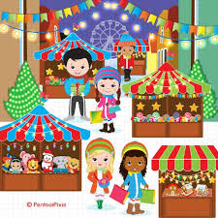
4) which of the following is not the major component of the holistic marketing?
A) Relationship marketing
B) Integrated marketing
C) Customer satisfaction
D) Socially- responsible marketing

Slide 44
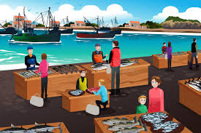
5) Which concept of marketing recognize that ”every thing matters” ?
A) the production concept
B) the product concept
C) the marketing concept
D) the holistic marketing concept

Slide 45
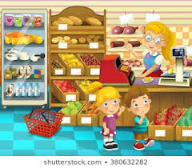
6) Goods which are brought frequently without much planning or shopping efforts and are also consumed quickly are known as:
A) Industrial goods
B) Specialty goods
C) Shopping goods
D) Convenience goods.

Slide 46
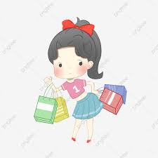
7) Which one of the following is not a factor while deciding demographic market environment?
A) Age
B) Gender
C) Family size
D) climate condition

